Slide 1
The Inclusive Data Taskforce
Dawn Snape
Assistant Deputy Director
Centre for Equalities and Inclusion

Slide 2
Content
Background
Taskforce findings and recommendations
Our initial response to their report
Governance considerations
How we can work together to support this work

Slide 3
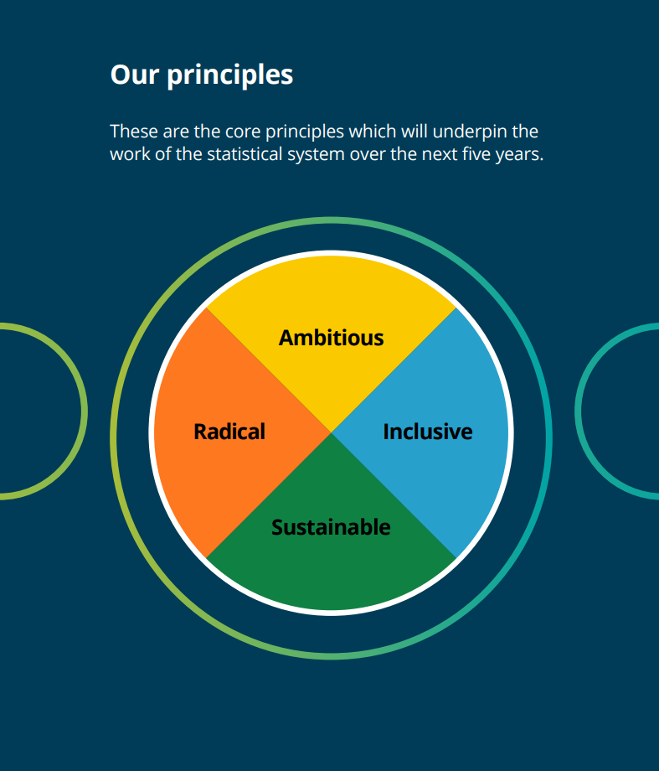
Why an Inclusive Data Taskforce?
To help realise the strategic vision of inclusivity.
To provide recommendations on how best to make a step-change in the inclusivity of UK data and evidence.
To ensure our statistics count everyone and that everyone counts in them.

Slide 4

What approach did the Taskforce take?
An ambitious engagement programme to listen and learn…
Online consultation Round table discussions
    Government and Devolved Administrations
    Academics, think tanks, research funders
    Civil society organisations
Facilitated events with equalities groups and the wider public;
Paper-based consultation with those at risk of digital exclusion

Slide 5

What did the Taskforce find?
Lack of trust/ trustworthiness in research participation & sharing info with government
Need to engage more with under-represented groups to make the (currently) invisible visible
Definitions/measures of protected characteristics must be reviewed to keep pace with society
Granularity is lacking due to small sample sizes hindering intersectional analysis;
Lived experience insights would enhance understanding
Inclusivity of access to data & evidence needs improvement

Slide 6
What did they recommend?
Eight key principles with 46 specific recommendations for action
Create an environment of trust and trustworthiness which allows and encourages everyone to count and be counted in UK data and evidence.
Take a whole system approach, working in partnership with others to improve the inclusiveness of UK data and evidence.
Ensure that all groups are robustly captured across key areas of life in UK data and review practices regularly.
Improve the UK data infrastructure to enable robust and reliable disaggregation and intersectional analysis across the full range of relevant groups and populations, and at differing levels of geography.
Ensure appropriateness and clarity over the concepts being measured across all data collected.
Broaden the range of methods that are routinely used and create new approaches to understanding experiences across the population of the UK.
Harmonised standards for relevant groups and populations should be reviewed at least every five years and updated and expanded where necessary, in line with changing social norms and respondent and user needs.
Ensure UK data and evidence are equally accessible to all, while protecting the identity and confidentiality of those sharing their data.

Slide 7
What is our initial response?
There is already strong commitment across the four nations of the UK, in the ONS and across government and the analytical professions, to taking action.
Our response last week set out our high level plan, the initial activities we would be undertaking (which the examples on this slide illustrate) and committed us to publishing a detailed workplan in January 2022 after consulting more widely with others.
Publication of an Equalities Data Navigator tool by ONS, to make it easier to find data; this will be regularly updated as new and improved data becomes available
Development of linked data on equality to enable improved analysis across people’s characteristics and circumstances through the Integrated Data Service working with the Government Equalities Office (GEO).
Improving engagement with under-represented groups by building on the 2021 Census community outreach work and increasing feedback to people on how their data have been used
Initiatives to identify currently under-represented groups of people in data including collaborative feasibility work between ONS, the Department for Levelling Up, Housing and Communities and the devolved administrations to improve data on people not living in households
Feasibility work will be undertaken on how new data sources can be used to fill data gaps using data science techniques and international collaboration. Qualitative research is also planned to understand more about the lived experiences of groups under-represented in UK data and evidence.
Improvements to surveys and other data sources that will enable more granular analysis of specific groups and areas of the UK, such as boost samples and the creation of multi-year pooled datasets by DCMS, DWP and DHSC.

Slide 8

Keeping momentum
Wide-reaching implications for our everyday work, affecting everyone
An independent committee will be established to monitor progress towards the recommendations
Reporting to the National Statistician
Transparent reporting will be key
Detailed operational plan with specific milestones published late January 2022

Slide 9
How can you support this work?
Champion the eight principles within your work
Consider how the 46 detailed recommendations may relate to your work and what you could do more of or differently going forward
Collaborate with others aiming to improve inclusive data and evidence to be more than the sum of our parts
Help to develop our operational plans by telling us about what you’re doing to improve inclusivity of data and evidence
Get in touch with your ideas or questions at Equalities@ons.gov.uk

Slide 10


Get in touch:
equalities@ons.gov.uk
www.ons.gov.uk/equalities

