Slide 1
Assessments of Local Well-being - Update
Kevin Griffiths
10 June 2021

Slide 2
What are Public Service Boards?
Statutory partners Statutory invitees
Local Health Board
Local Authority
Fire & Rescue
NRW
Welsh Ministers
Chief Constable
PCC
Probation Services
Third Sector

Slide 3
What must they do?
Prepare assessment of local well-being
Publish assessment
Prepare local well-being plan
Publish Local well-being plan
Report annually on progress
5 May 2022
May 2023

Slide 4
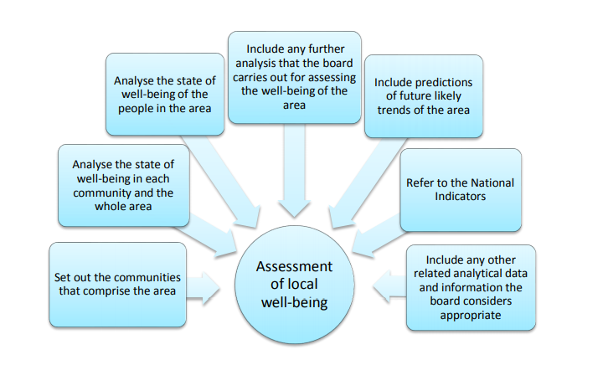
How are they done?

Slide 5
What did we learn from last time?
Data analysis capacity – less this time than previously
Community/citizen engagement wasn’t that strong
Futures work wasn’t well developed (FTR timing)
Join up with intel from other bodies – variable.
(Recognise the pace and newness of the previous round)

Slide 6
What support are we offering?
Support grant
Core data set
Data/knowledge catalogue and webinars
Drop-in clinics
WCPP thematic bulletins
Futures – Future Trends; NRW and FGC support
Engagement - seminars. From Coproduction Wales and FGC.
Join-up with RPB colleagues

Slide 7
What next?
Support is ongoing…
Consultation in Winter 2021/22
Looking ahead to plans -> evidence of what works and prior learning

