Slide 1
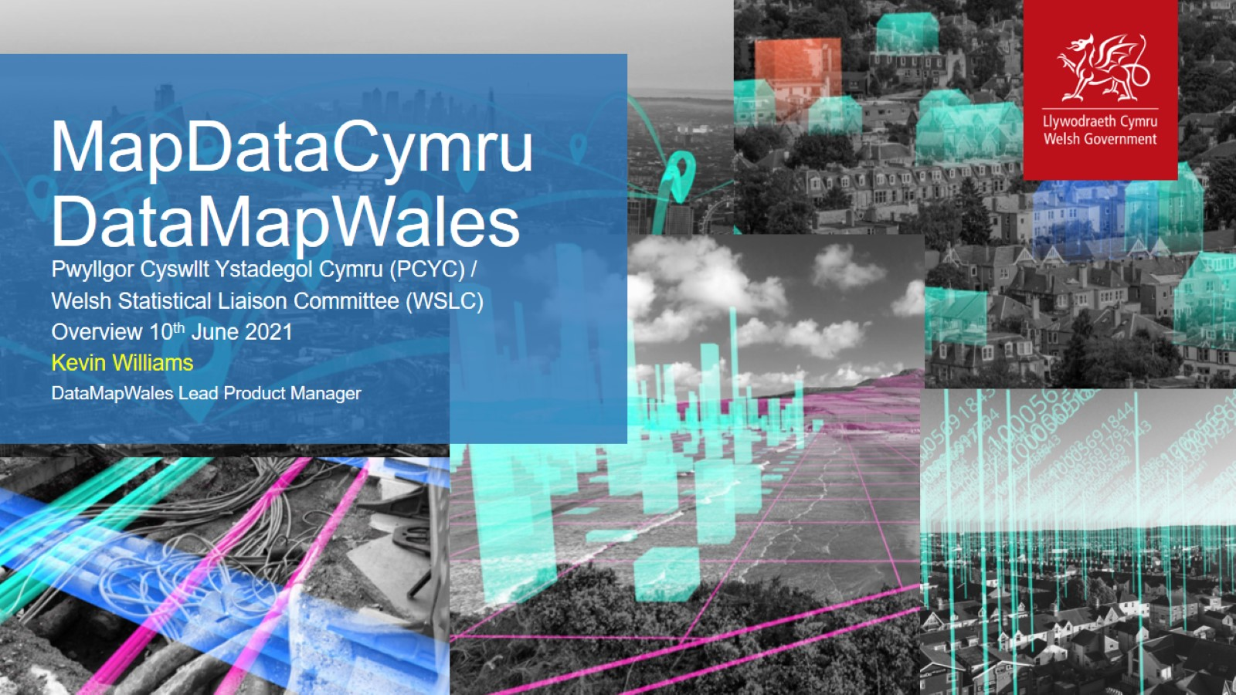
MapDataCymru
DataMapWales

Slide 2
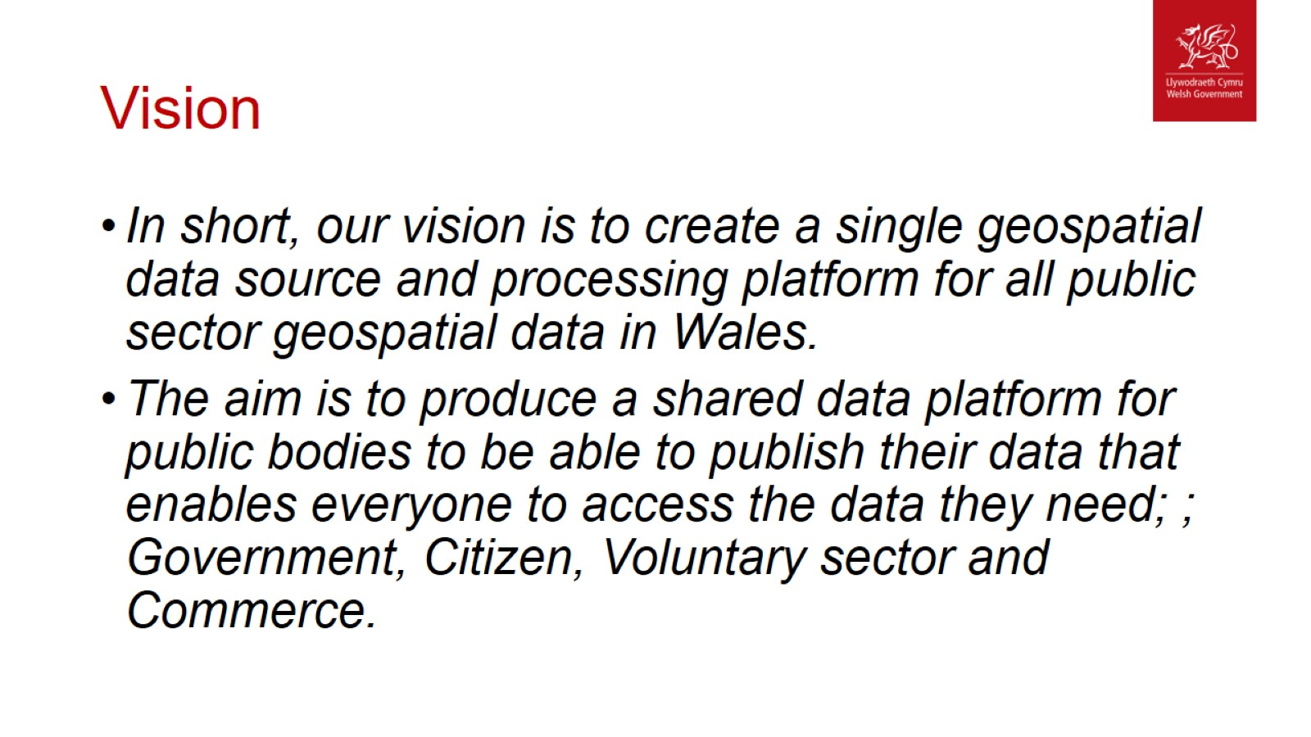
Vision

Slide 3
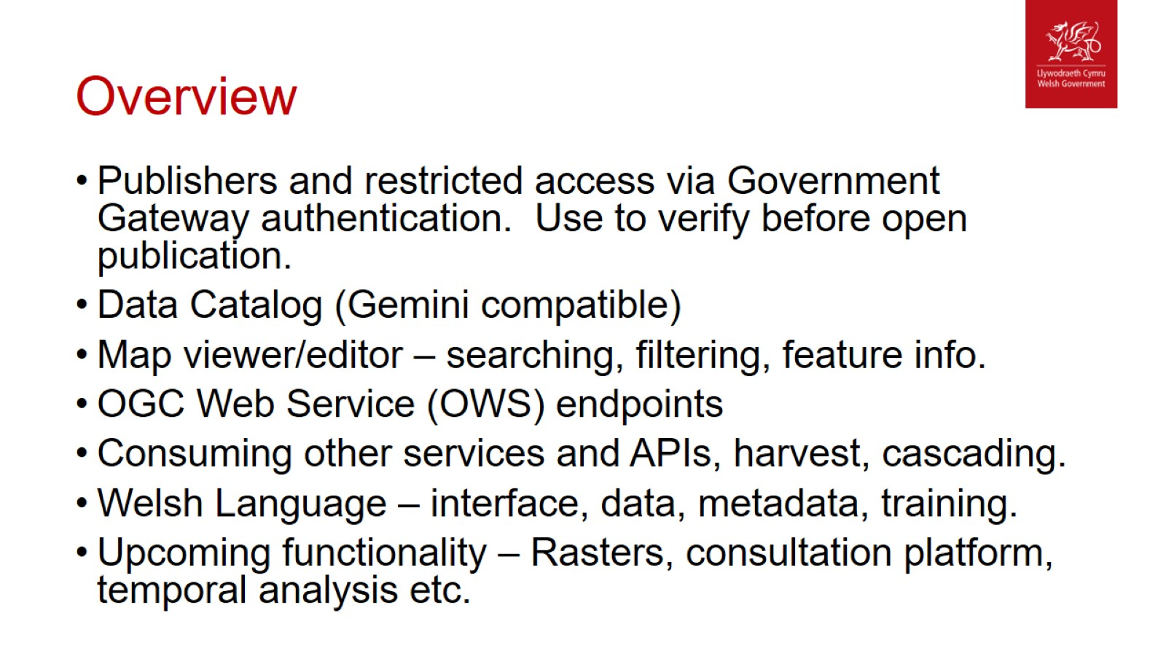
Overview

Slide 4
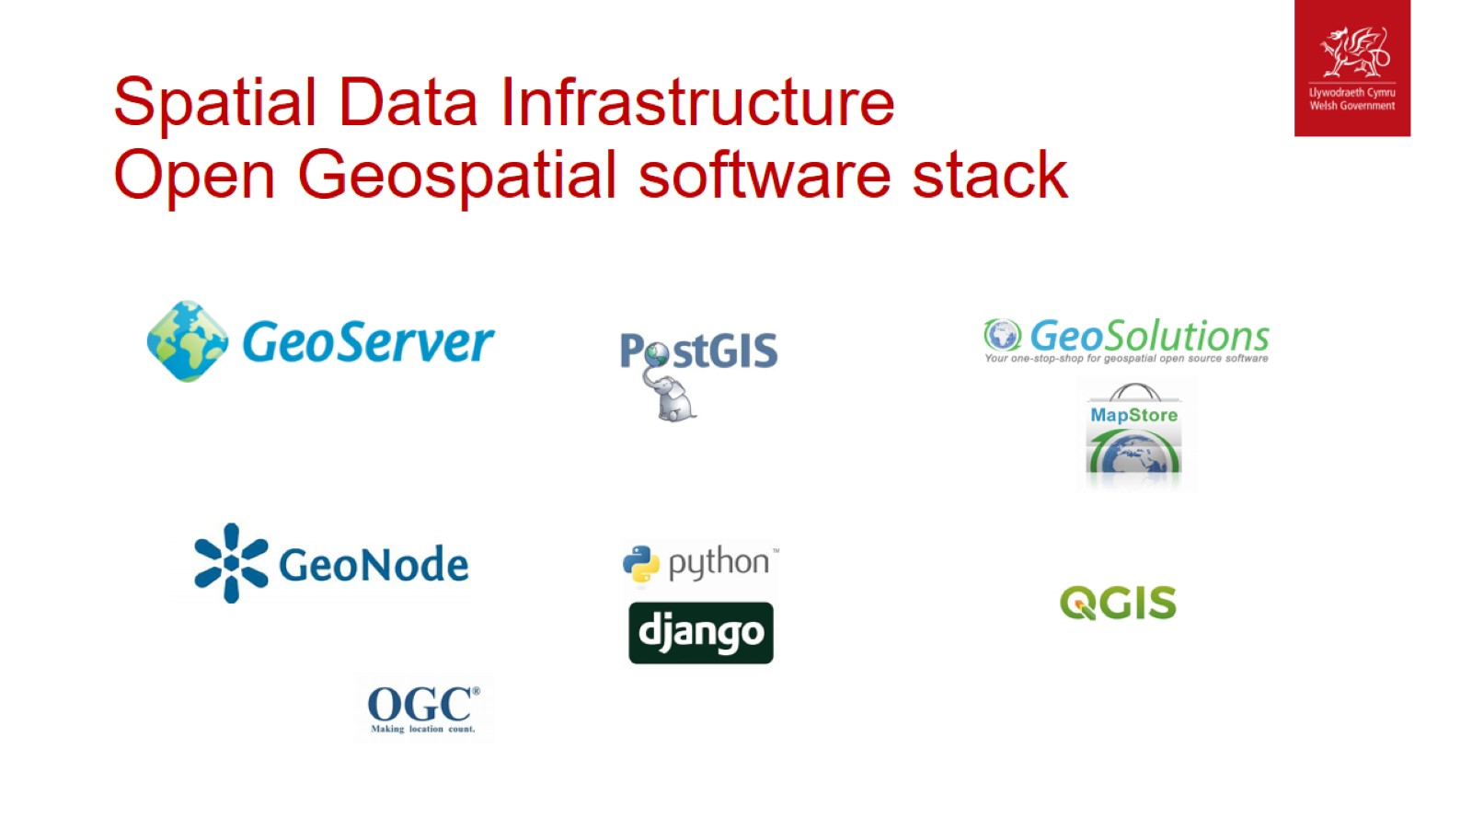
Spatial Data Infrastructure
Open Geospatial software stack

