Slide 1
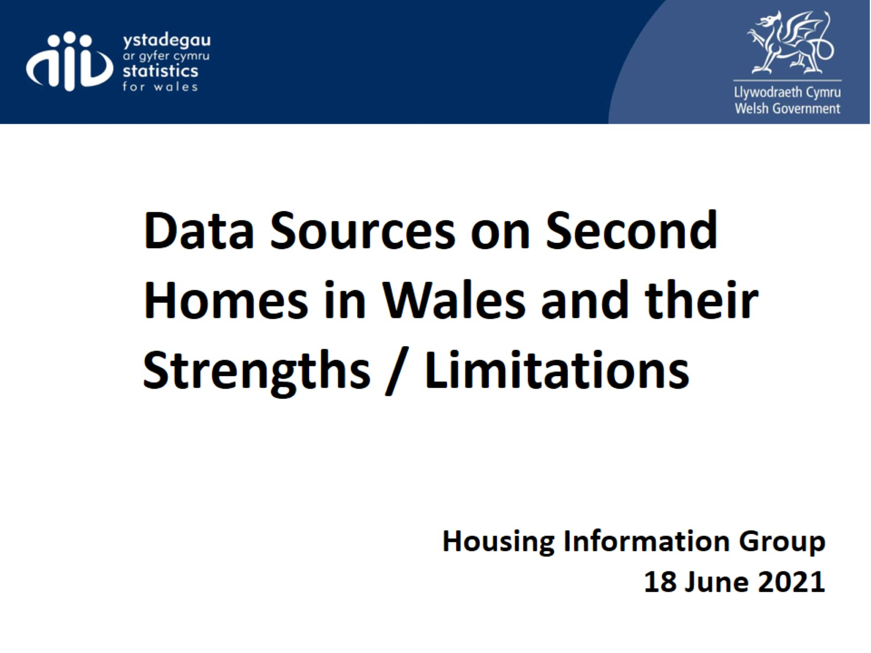

Slide 2
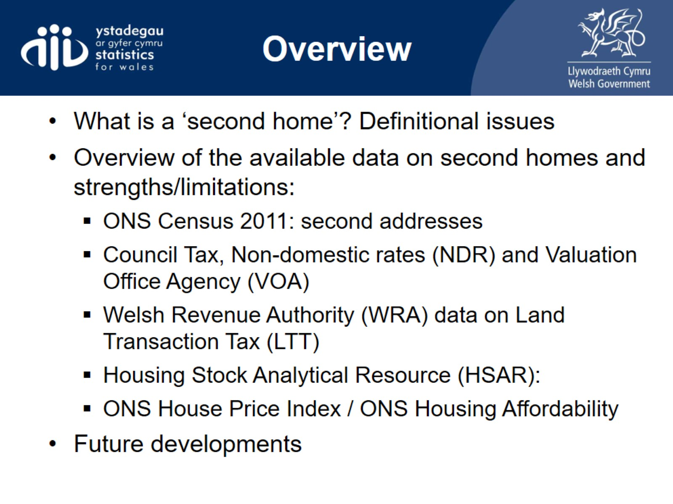
Overview

Slide 3
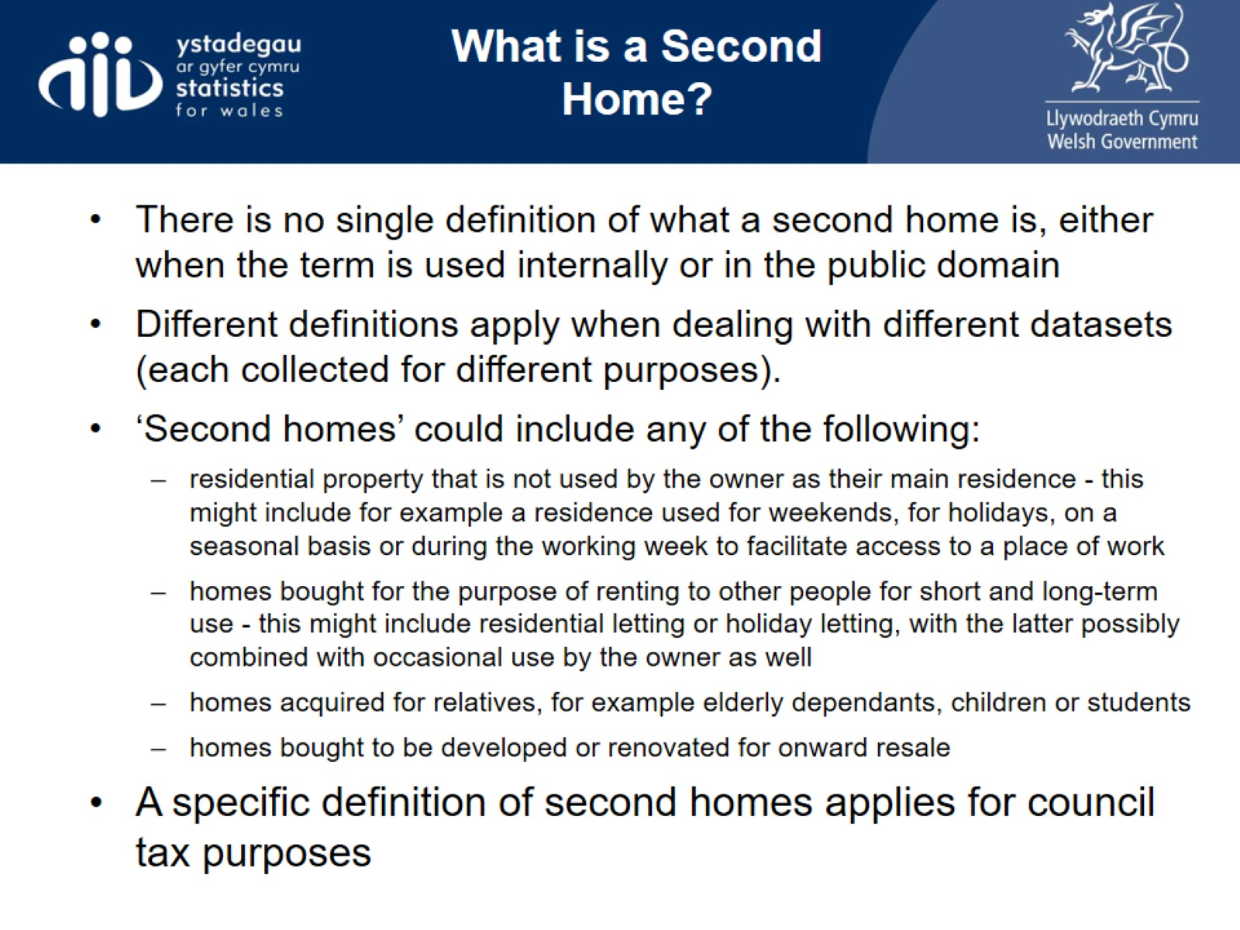
What is a Second Home?

Slide 4
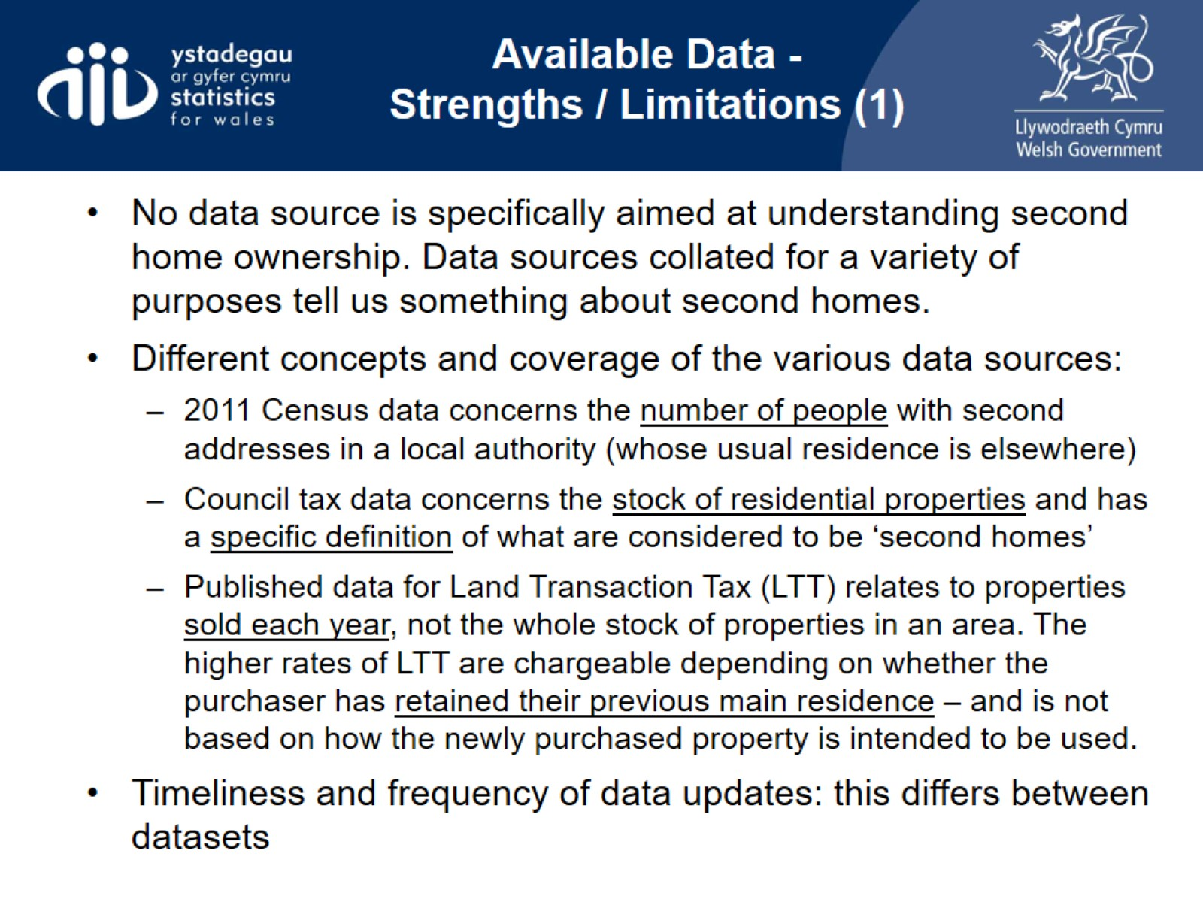
Available Data -
Strengths / Limitations (1)

Slide 5
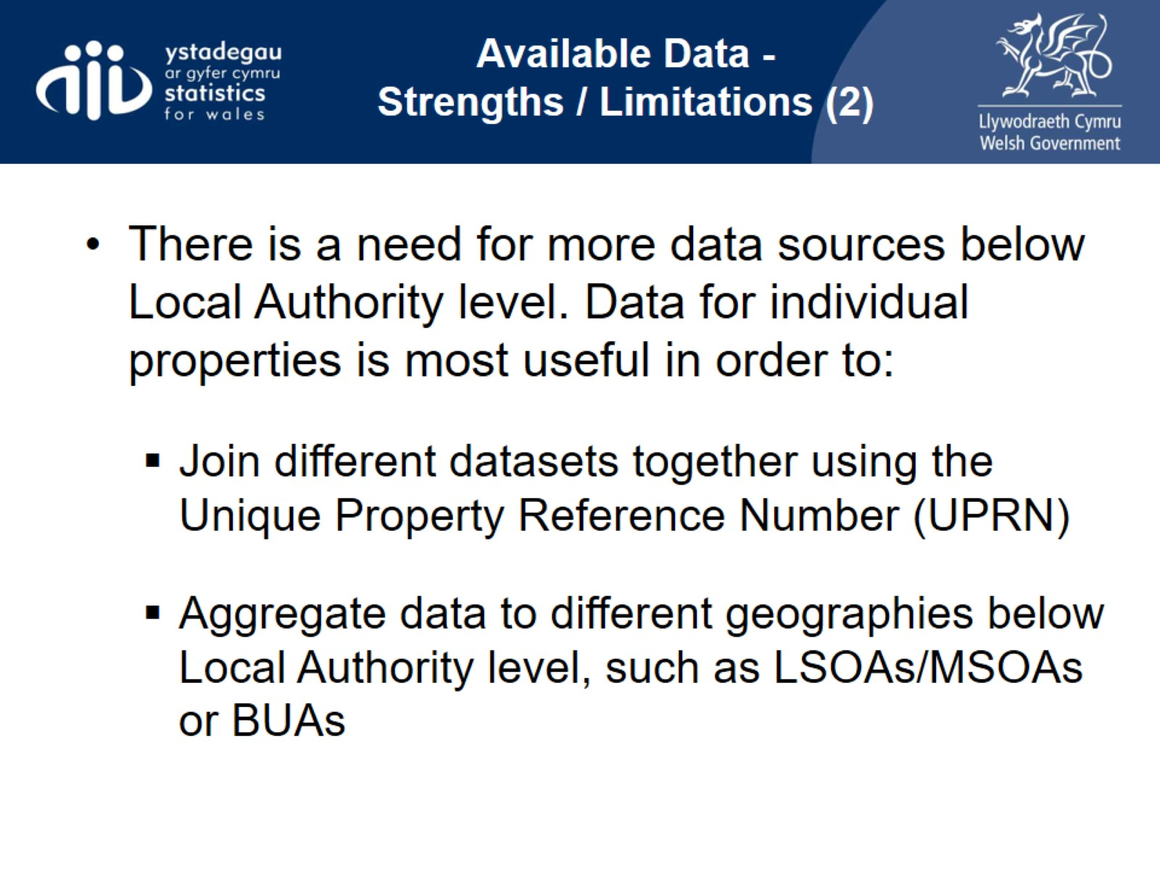
Available Data -
Strengths / Limitations (2)

Slide 6
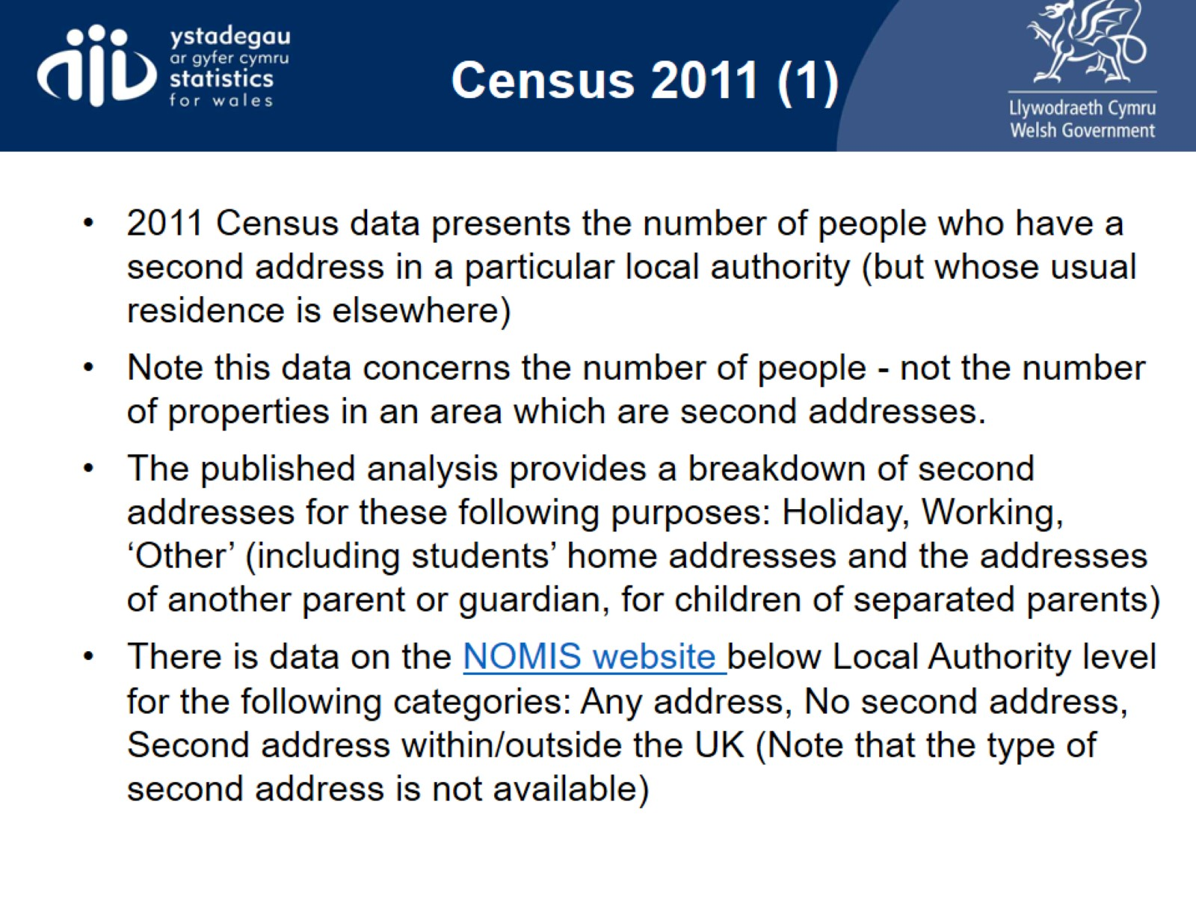
Census 2011 (1)

Slide 7
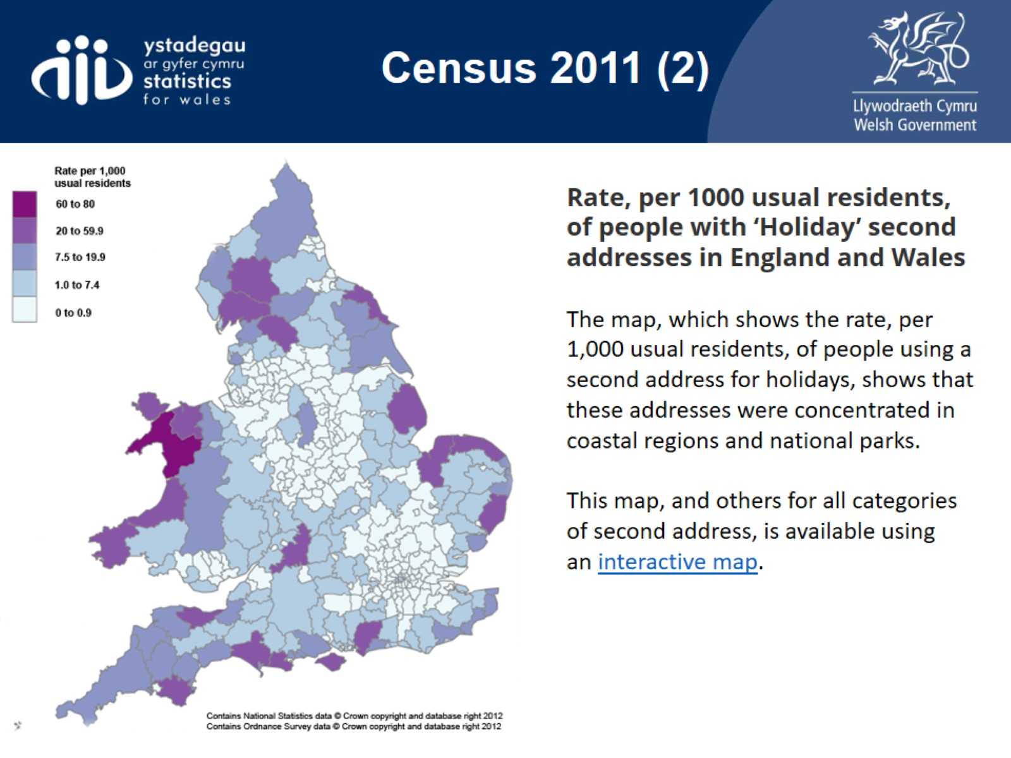
Census 2011 (2)

Slide 8
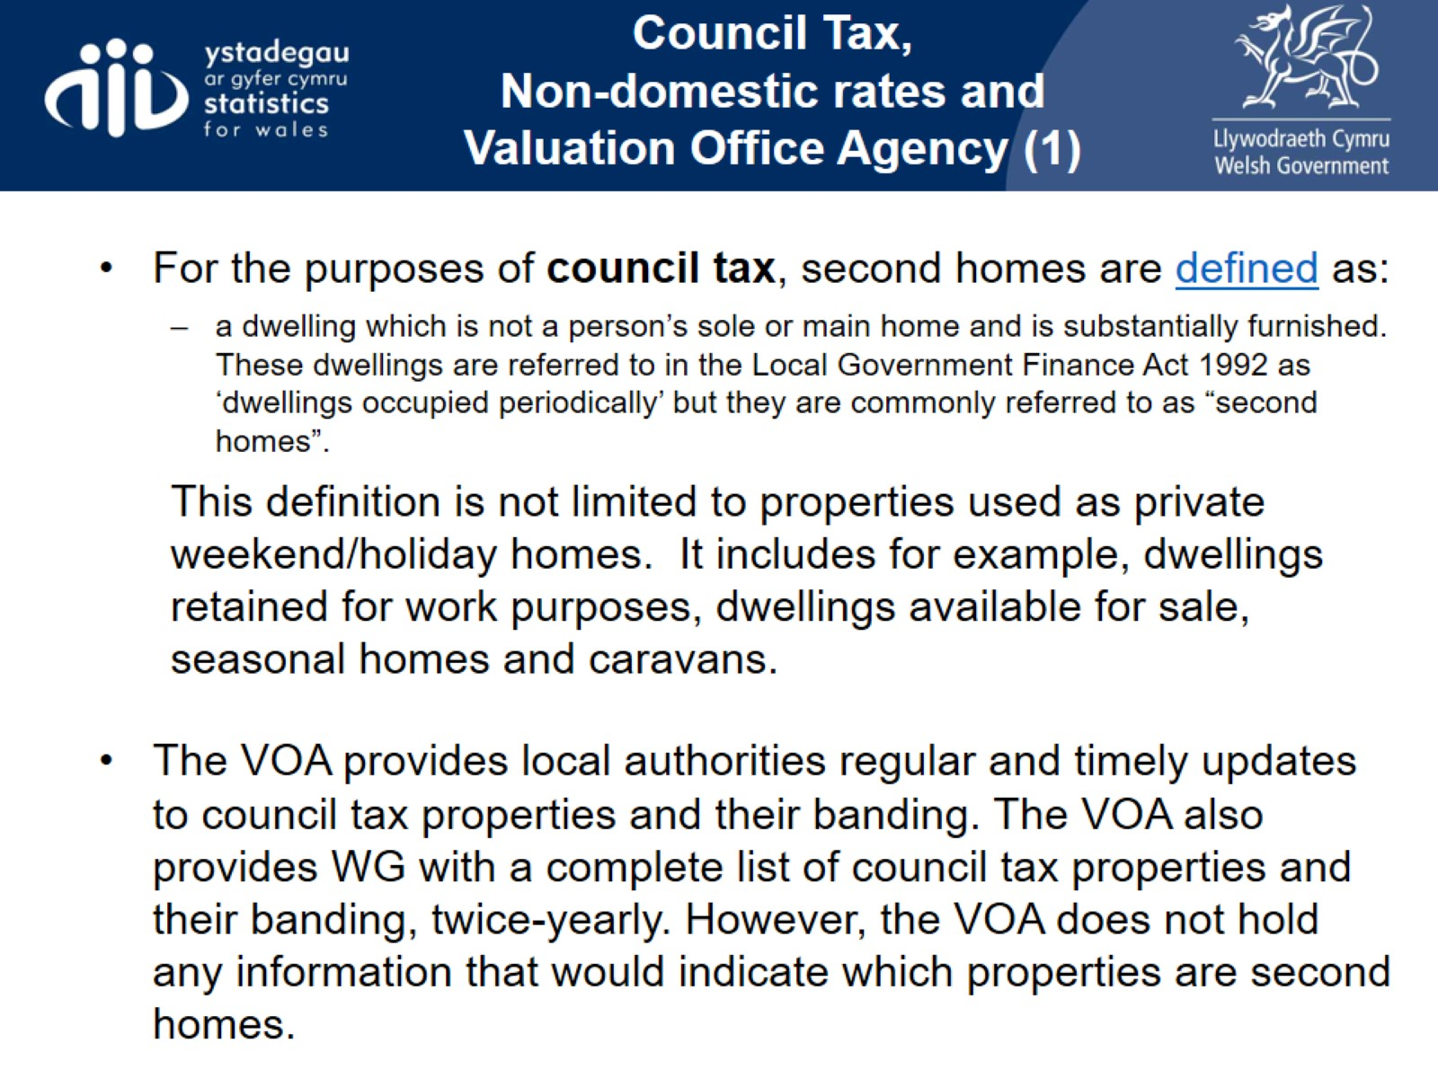
Council Tax,
Non-domestic rates and Valuation Office Agency (1)

Slide 9
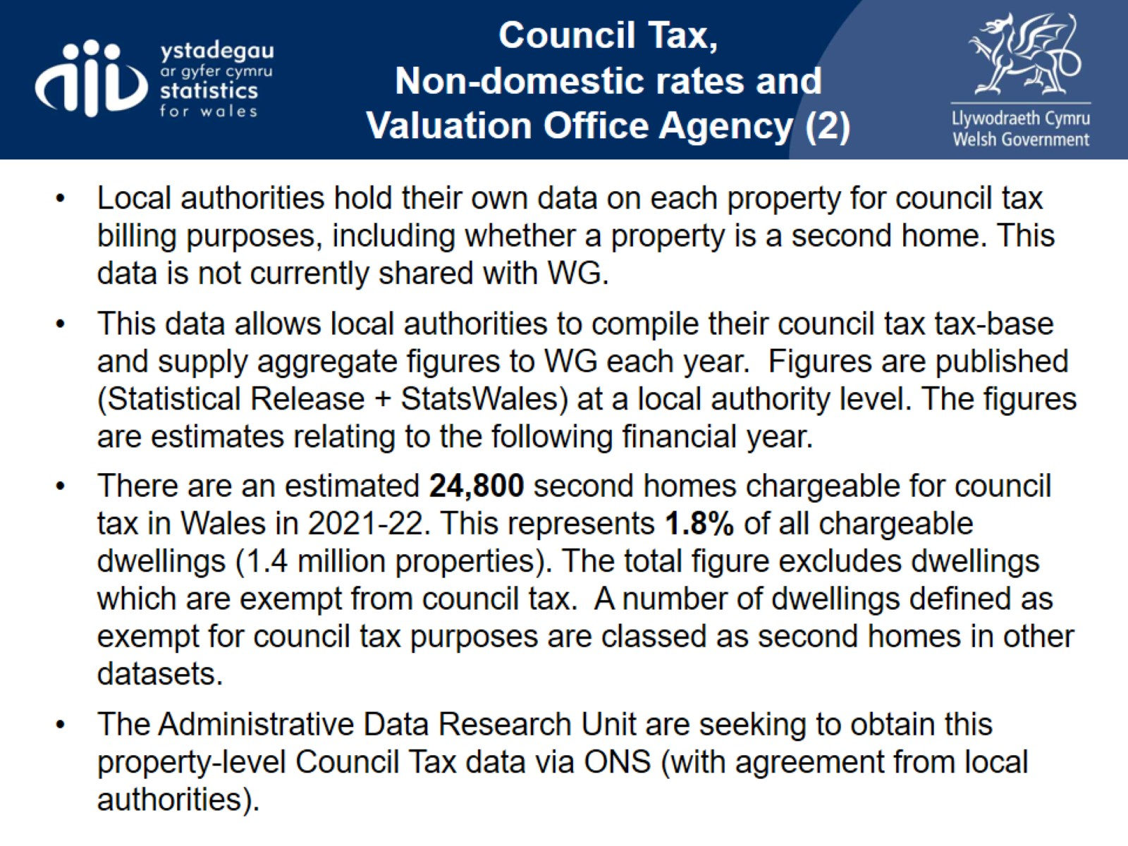
Council Tax,
Non-domestic rates and Valuation Office Agency (2)

Slide 10
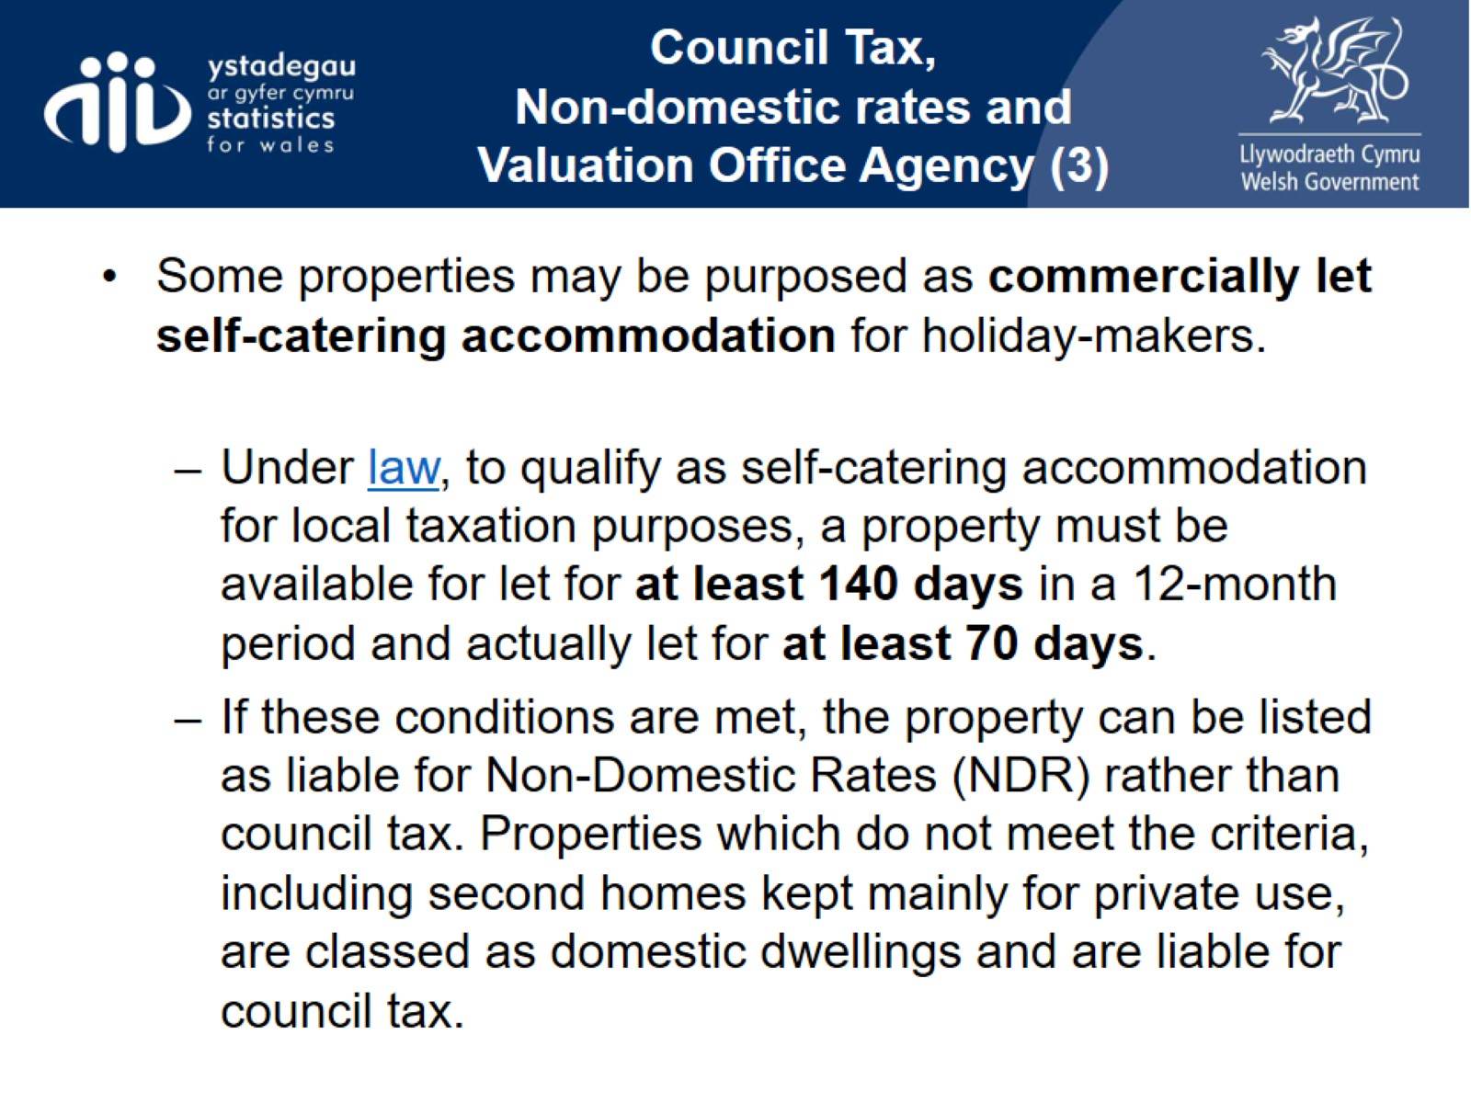
Council Tax,
Non-domestic rates and Valuation Office Agency (3)

Slide 11
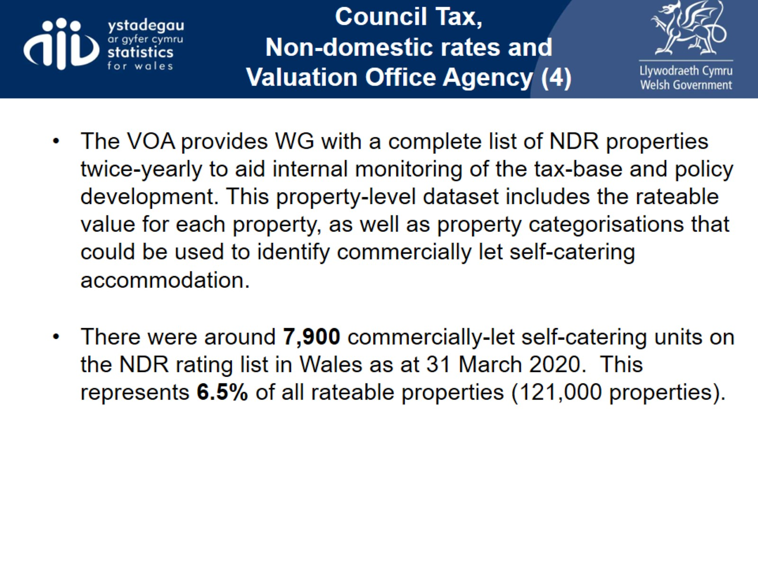
Council Tax,
Non-domestic rates and Valuation Office Agency (4)

Slide 12
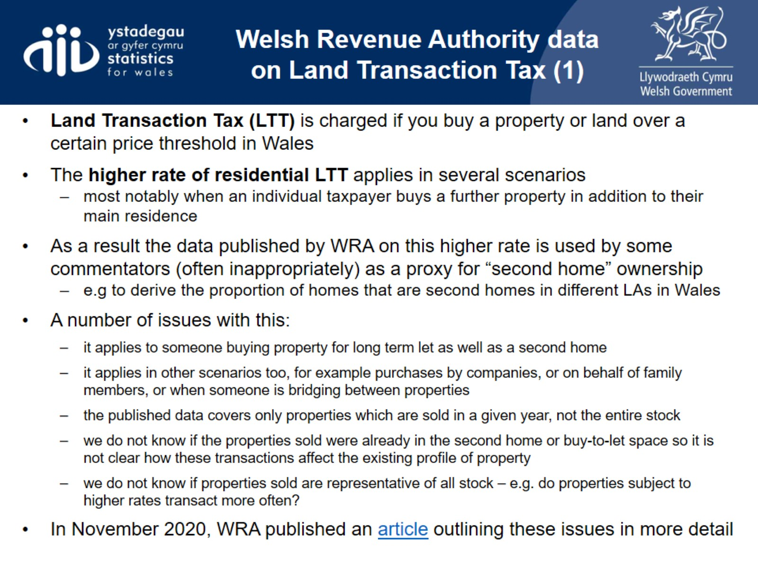
Welsh Revenue Authority data on Land Transaction Tax (1)

Slide 13
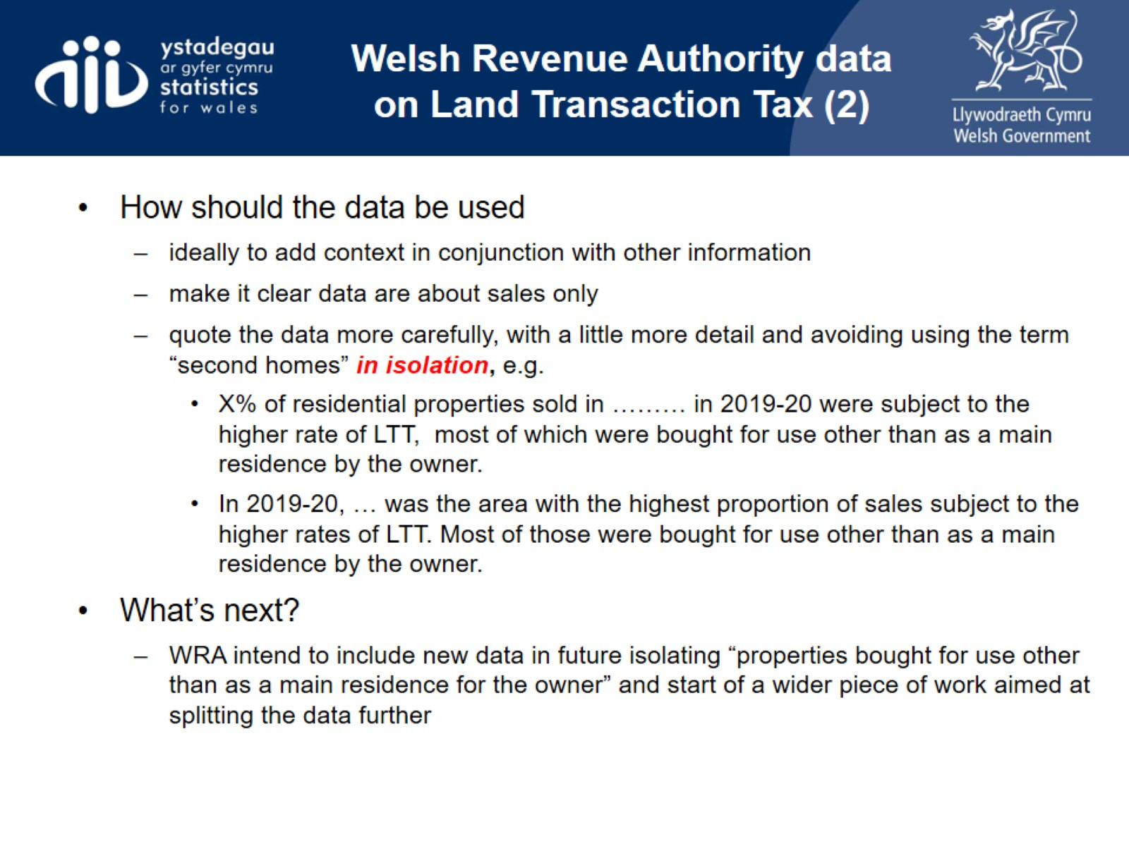
Welsh Revenue Authority data on Land Transaction Tax (2)

Slide 14
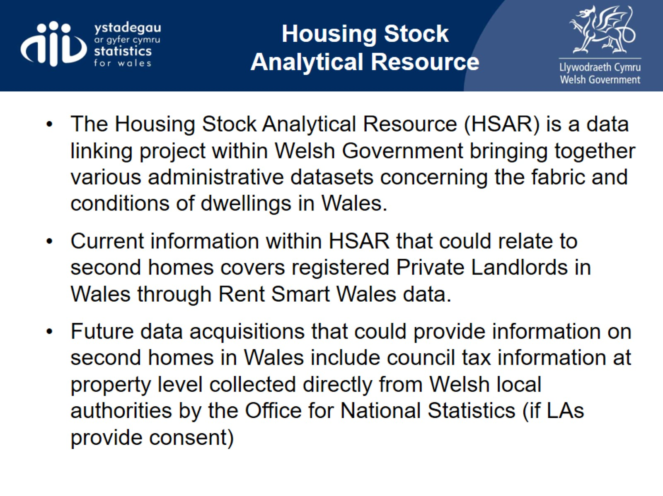
Housing Stock
Analytical Resource

Slide 15
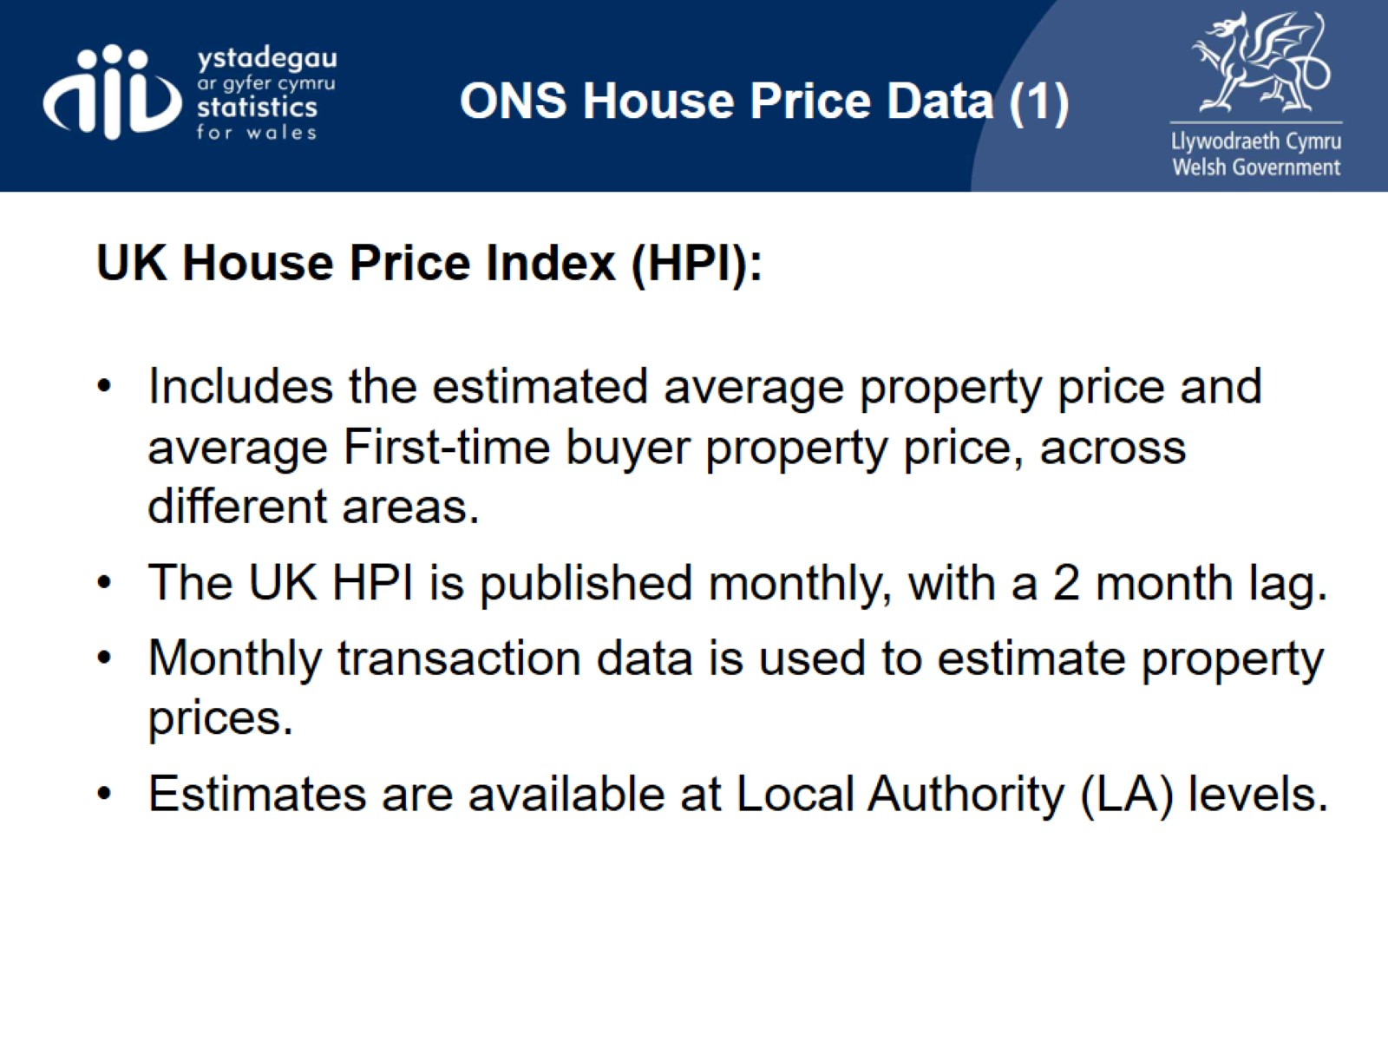
ONS House Price Data (1)

Slide 16
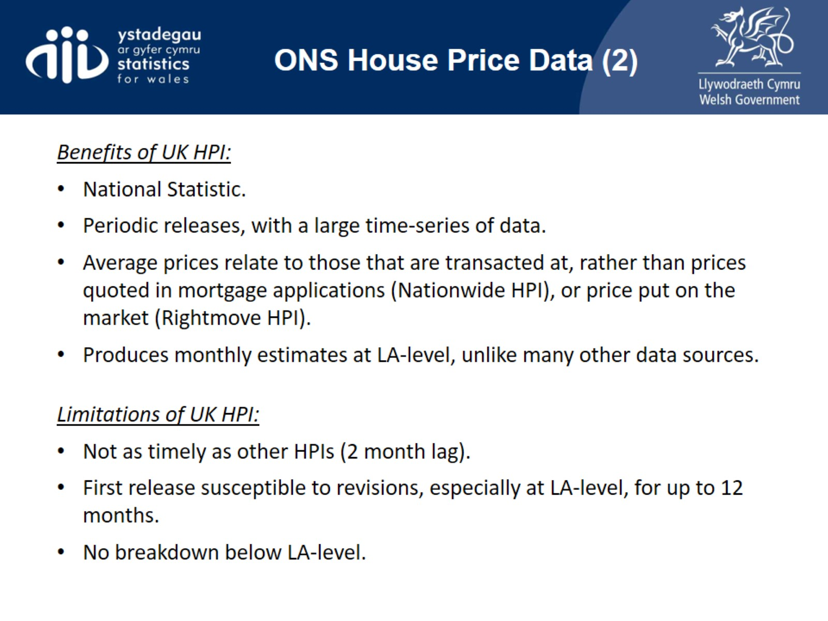
ONS House Price Data (2)

Slide 17
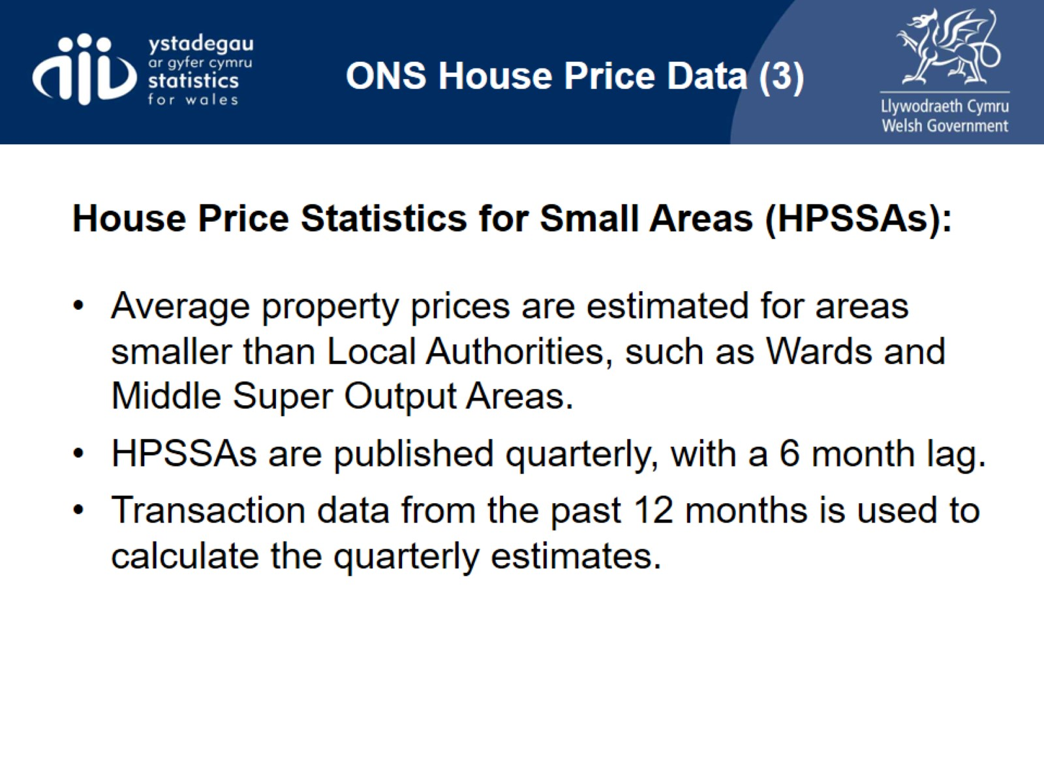
ONS House Price Data (3)

Slide 18
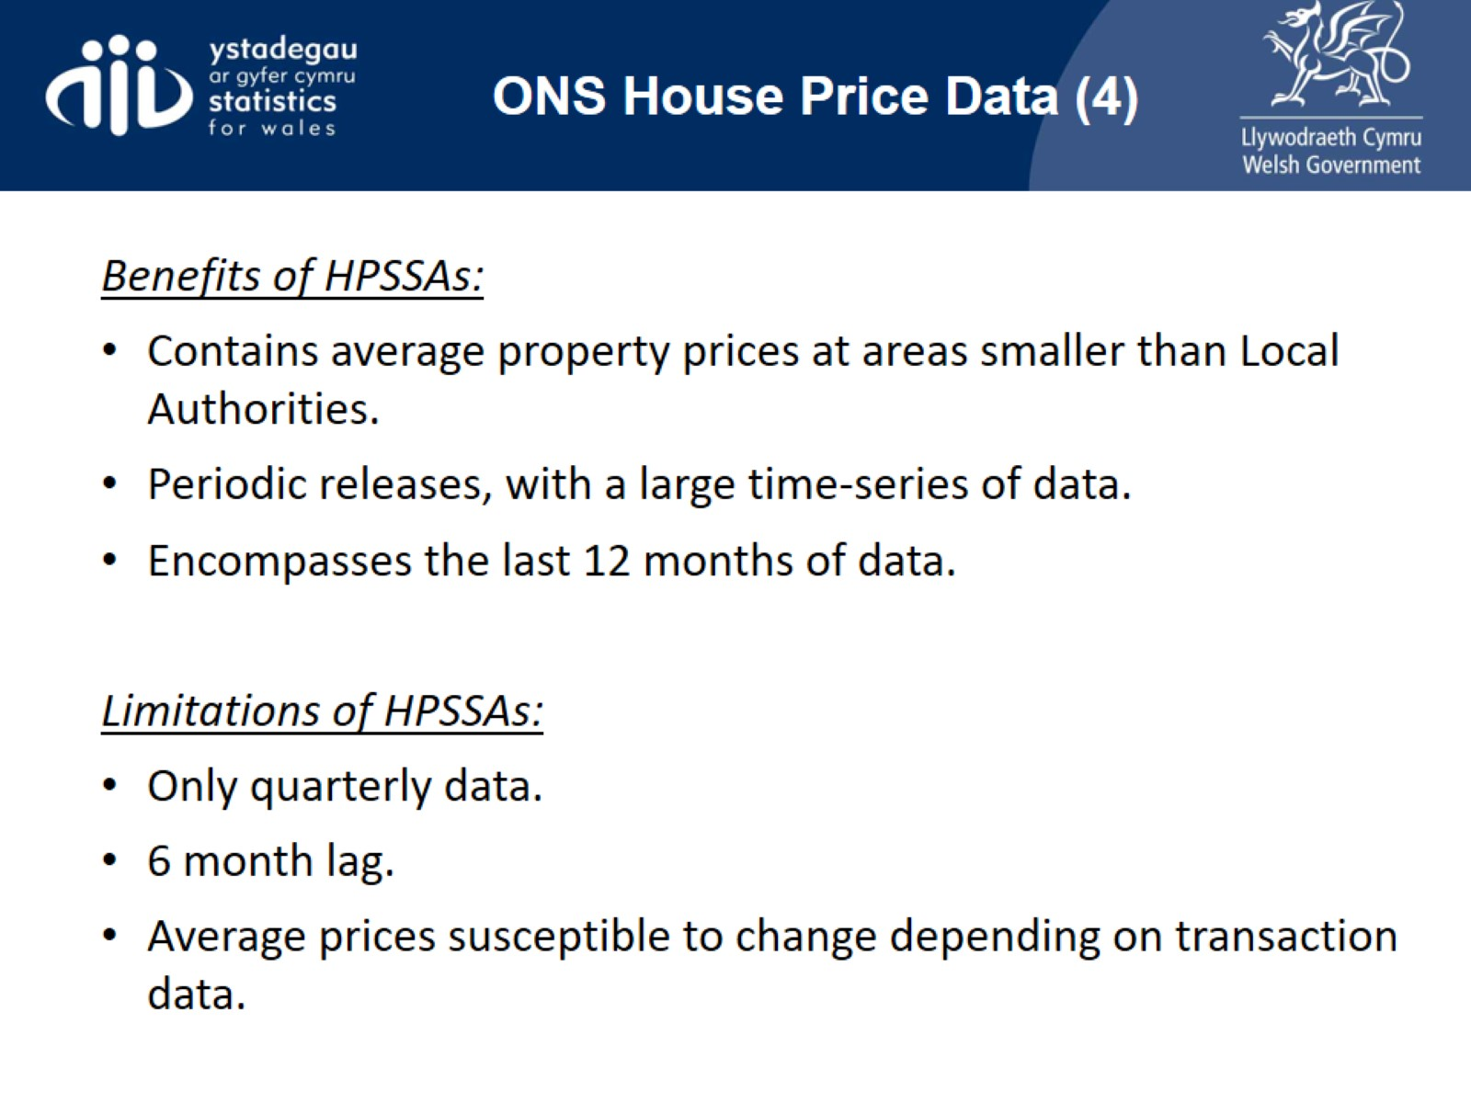
ONS House Price Data (4)

Slide 19
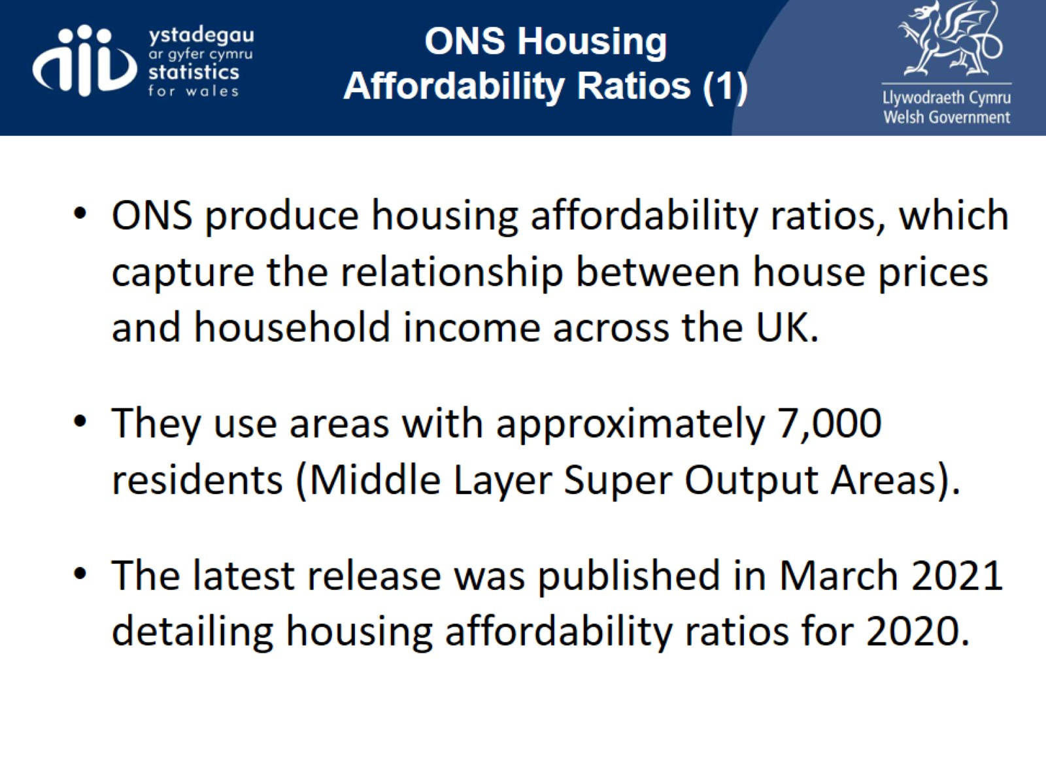
ONS Housing Affordability Ratios (1)

Slide 20
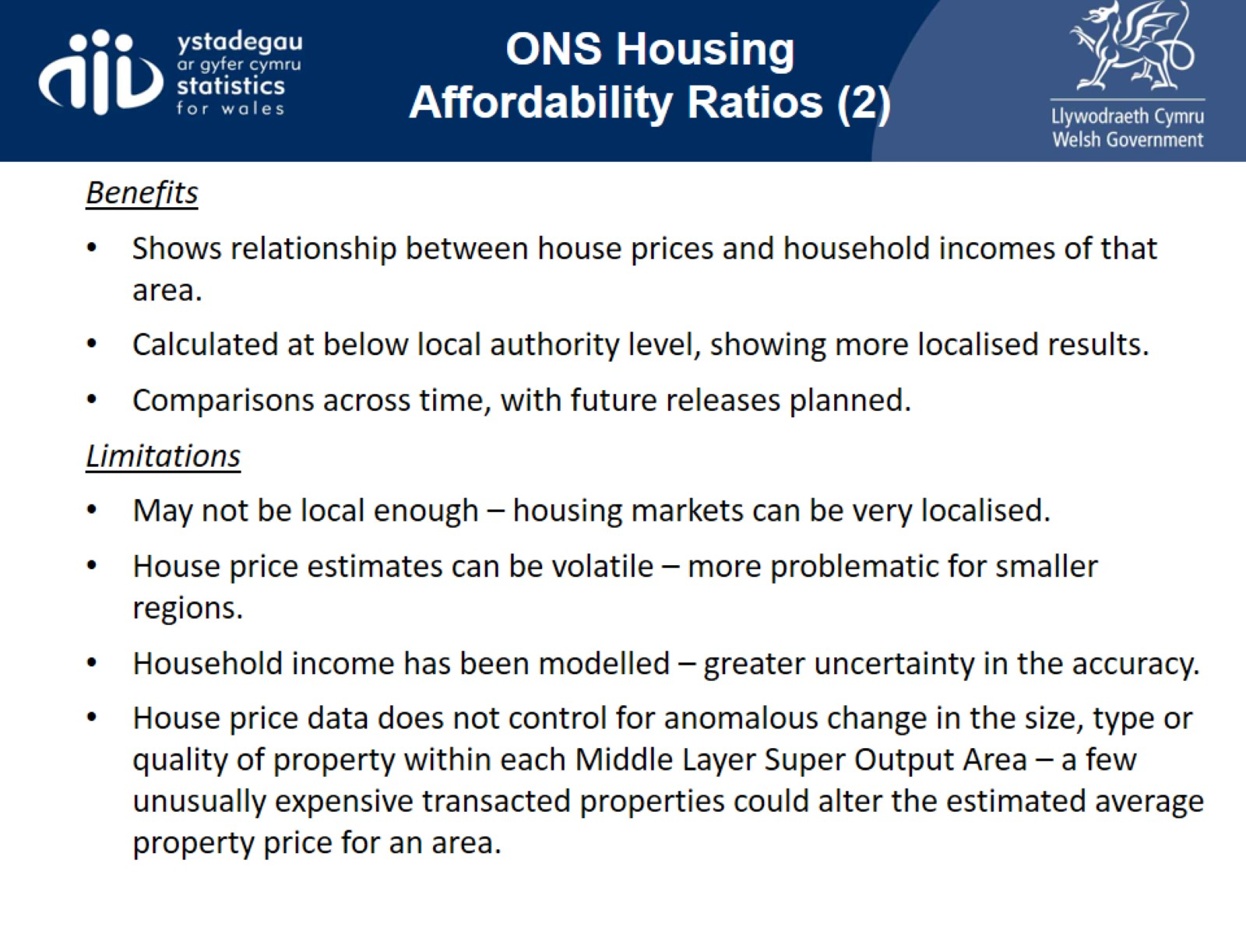
ONS Housing Affordability Ratios (2)

Slide 21
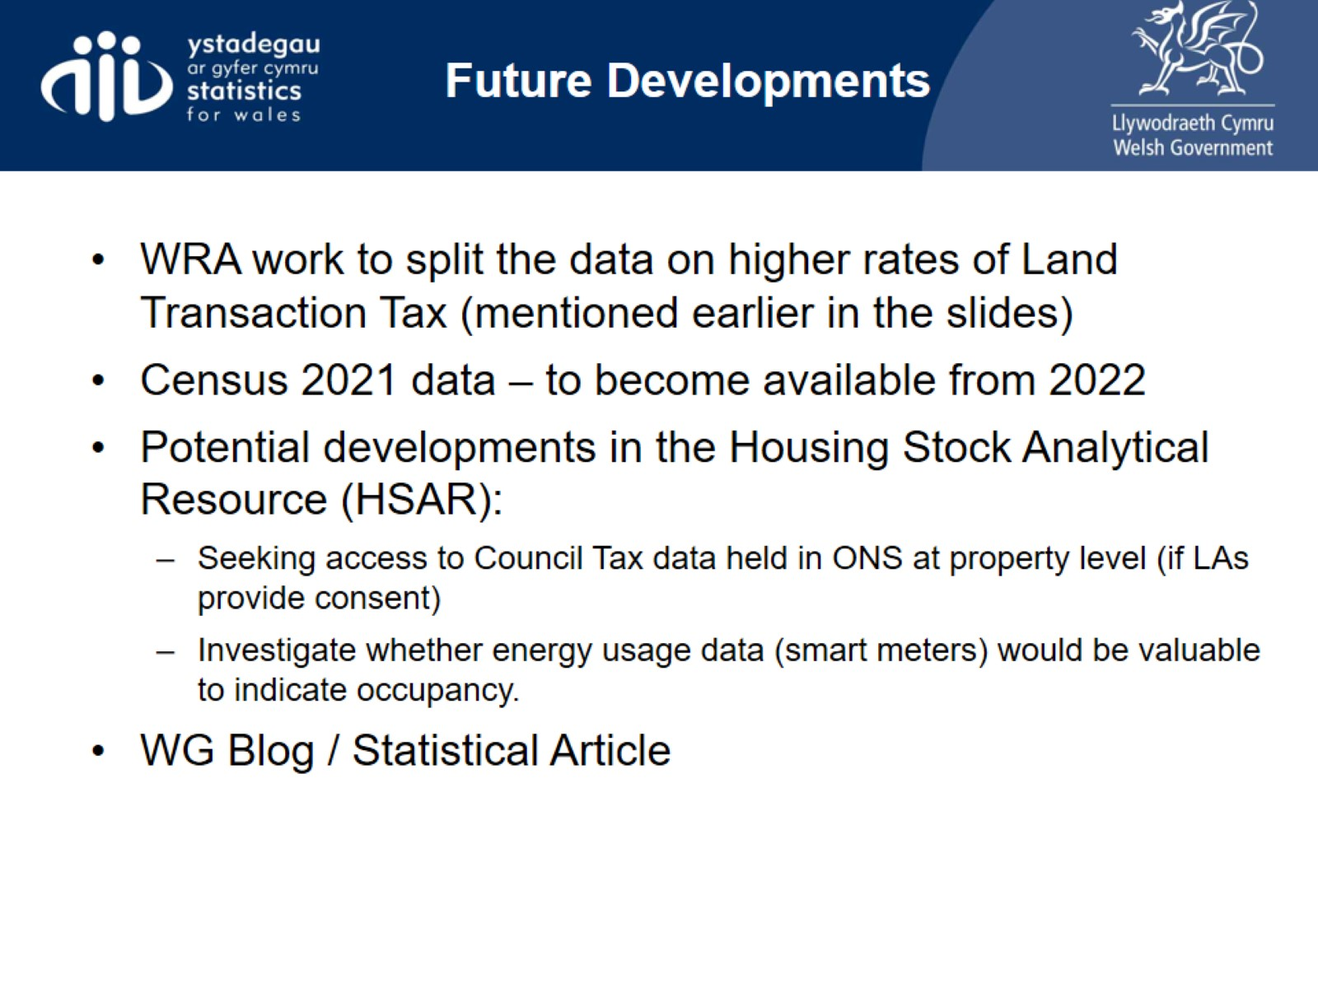
Future Developments

Slide 22
