Slide 2

About Llamau

Slide 3
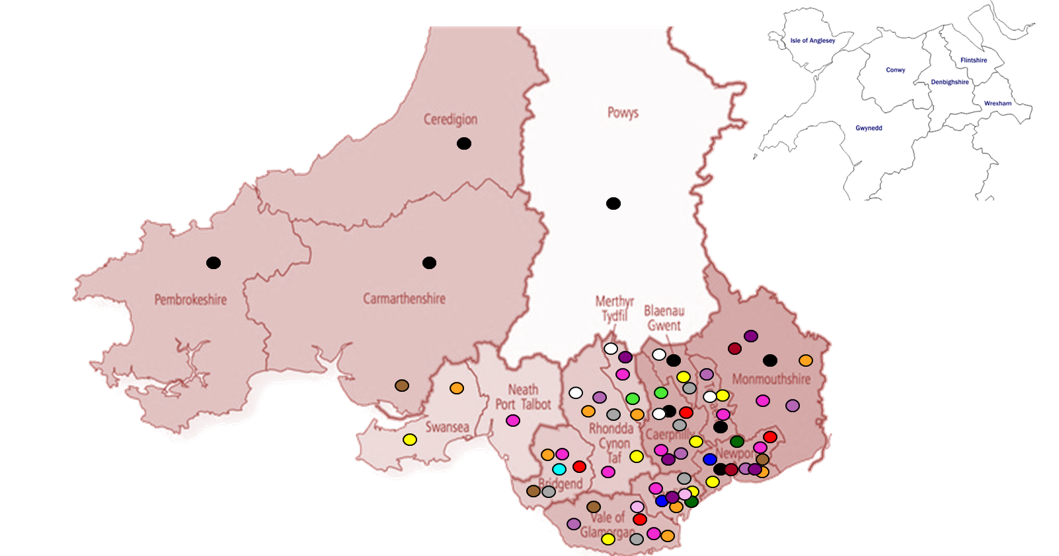
Our Services
Supported Housing - SAFE
Supported Housing – YP
Supported Housing Women
Refuge
Floating Support YP
Floating Support Women
Floating Support Generic
DA outreach/floating support
EMPHASIS
IDVA
Housing Advice Centres YP
Supported Lodging
Mediation
Missing Children
Symud Ymlaen
L4L

Slide 4

Our services
YOUNG PEOPLE
Supported Housing incl. LGBTQ+ specific
Floating Support/TSS
Supported Lodgings
EMPHASIS
Mediation and Advice Services
Missing Children
Youth Homelessness Helpline
Healthy Relationships support
Learning 4 Life & Symud Ymlaen/Moving Forward

Slide 5
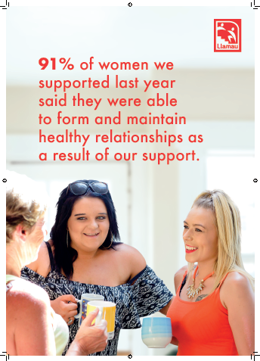
Our services
WOMEN
Supported Housing
Family Work
Healthy Relationships groups
Domestic Abuse Services / Refuge
EYHC Lead Partner
EYHUK Welsh Partner
ADDITIONAL

Slide 6

Our data journey

Slide 7
Monitoring & Evaluation Team

Slide 8
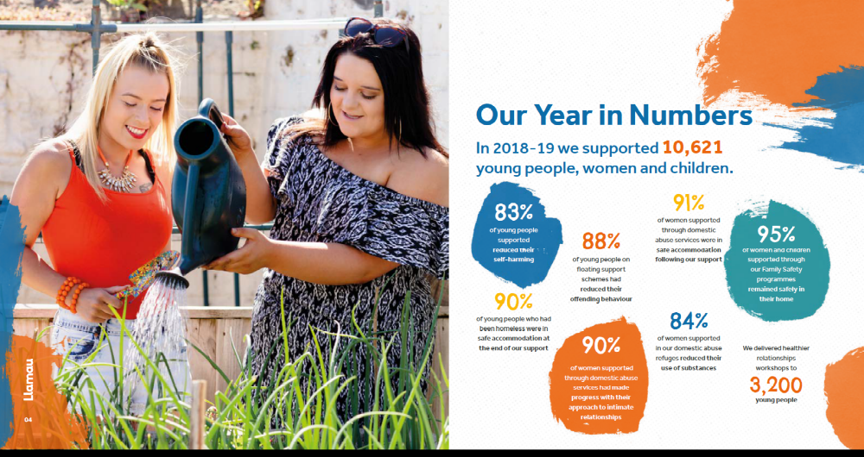
We collect a lot of data!

Slide 9
Our DataKind
data dive

Slide 10
Our questions
Of the people actively using Llamau’s services, which are benefiting the most from Llamau’s programs and why?
Which services and projects are achieving the most successful outcomes for the individuals Llamau serves and why?
What improvements should be made to Llamau’s existing Case Management System for collecting data?

Slide 11
Findings
Young men, who have a history of youth offending and are care leavers, show lower levels of progression
There was a positive correlation between a young person’s engagement with a service and their outcomes
BUT
Some projects had less positive outcomes despite how well engaged individuals were.

Slide 12
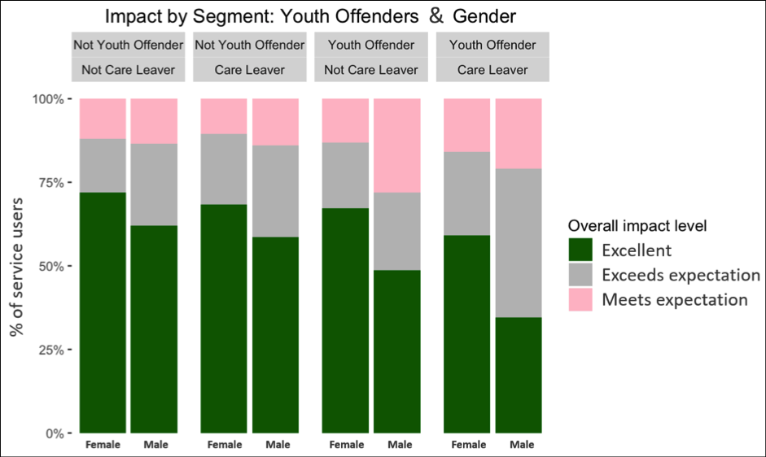

Slide 13
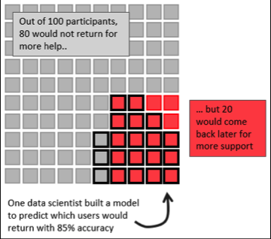

Slide 14
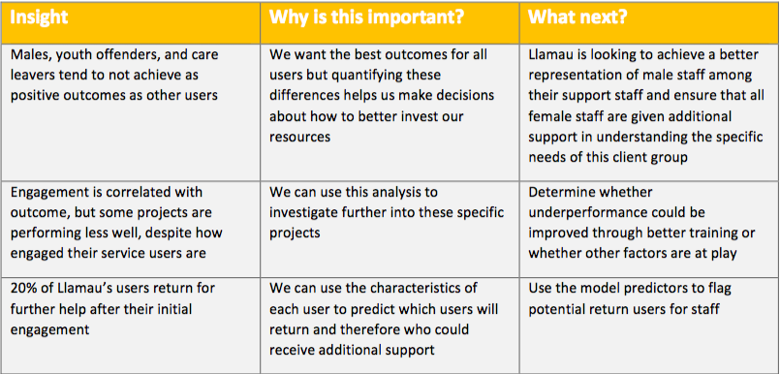

Slide 15
Being more data aware

Slide 16

The journey continues
Improving our systems
Developing our dashboard
AVP Volunteers
Aware of current limitations
Notes:
Learning

Slide 17

Our challenges
Are we asking the right questions?
Are we consistent?
Too subjective?
Inaccurate data entry
Reporting needs constantly changing
Getting the right info at the right time

Slide 18
More challenges!
Lack of specific expertise
Lack of live data
Not all services on one system or held centrally
Multiple reporting and dissemination loops
Core ‘reporting’ but many services also need ‘specific’ measures
The big one – what if our results go down as accuracy increases – comms on this!

Slide 19
Our strengths…
We know what we want to achieve
A positive continuous learning culture
Some centralised systems
Links with universities, access to students/volunteers
A P.I.E. framework to guide some elements
Our Monitoring & Evaluation team!
Total Colleagues working with Llamau
420 (and growing!)

Slide 20
Next steps
Our data analyst has just started!
Improving our case management systems
Get our dashboard working
Continue learning and improving

Slide 21
Any questions?

