Slide 1
Effaith y pandemig ar y farchnad lafur
The impact of the pandemic on the labour market
Luned Jones & Melanie Brown
Panel Defnyddwyr Ystadegau’r Trydydd Sector
Third Sector Statistics User Panel
12.11.20
Notes:
Introduce ourselves.

Slide 2
Amlinelliad Outline
Cyflwyniad
Y farchnad lafur cyn COVID-19
Yr wybodaeth ddiweddaraf
  Prif ddangosyddion diweddaraf
  Ffyrlo a chynlluniau Cymorth eraill
  Swyddi Gwag
  BICS
Gwybodaeth Bellach
Cwestiynau
Introduction
Labour market pre COVID-19
Latest data
  headline labour market indicators
  Furlough and other support schemes
  Job vacancies
  BICS
Further information
Questions

Slide 3
Cyflwyniad Introduction
Ein rol
  Cyhoeddi dadansoddiad cryno
  Cynhyrchu briffiau mewnol i Weinidogion a chydweithwyr polisi
  Ymateb i geisiadau mewnol ac allanol ad hoc.
Heriau data:
Argaeledd data
Ansawdd a chyfyngiadau
Oedi
Cydlyniad
Our role
  Publish summary analysis
  Produce internal briefing for Ministers and policy colleagues
  Respond to ad-hoc internal and external requests.
Data Challenges:
Availability of data
Quality and limitations
Time lag
Coherence
Notes:
Small economic statistics team that work with other analysts within WG and across the GSS.
Part of our role is to analyse and advise on the various data sources published by other departments such as ONS and HMRC. As part of this we:
Publish summary analysis of these data
Produce internal briefing for Ministers and policy colleagues
Respond to ad-hoc internal and external requests.
Challenges:
Availability of data
Quality and limitations of data (for example some of the data are based on sample surveys and have an associated uncertainty, some are administrative sources and have not undergone as much QA)
Time lag – some of the data sources
It can be challenging to pull together an overall narrative from the various sources. Occasionally contradict each other, or slightly different emerging findings.

Slide 4
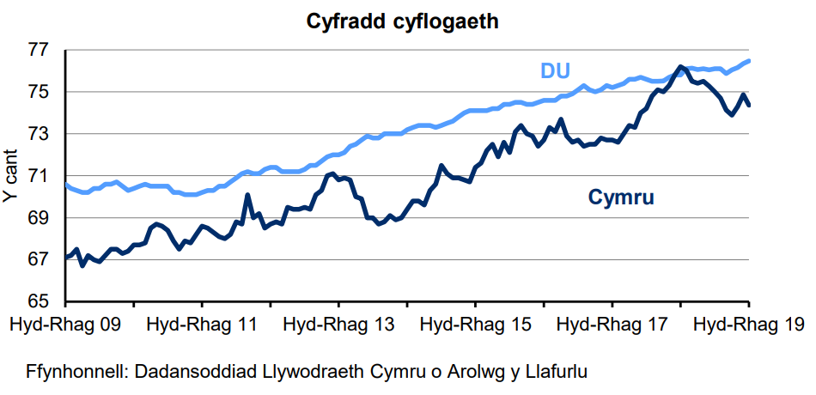
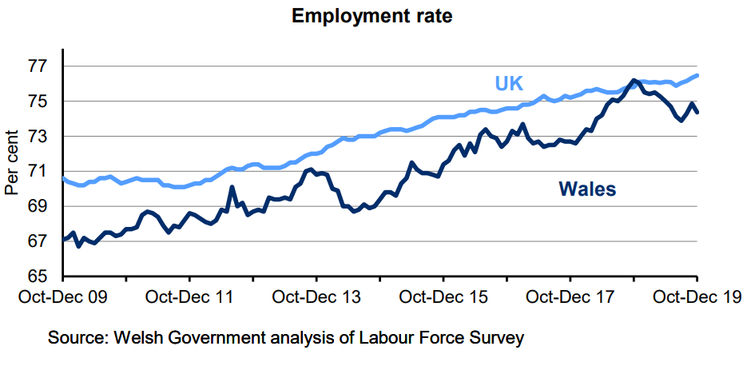
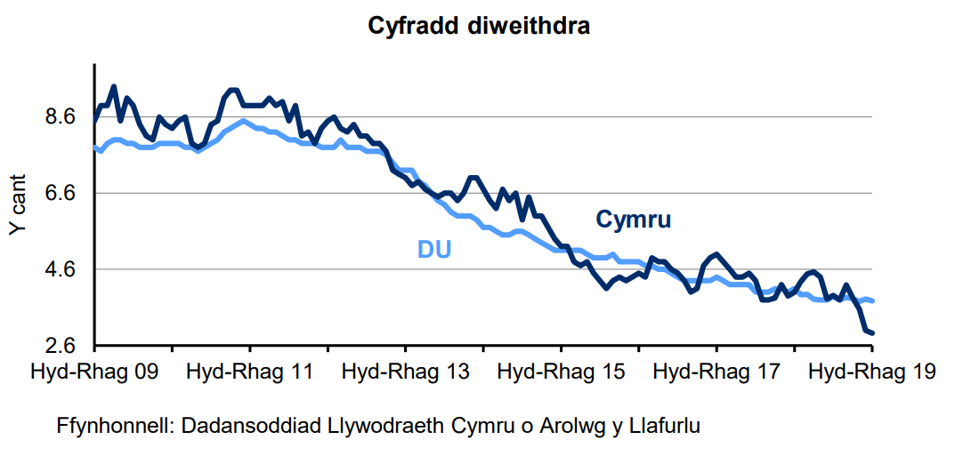
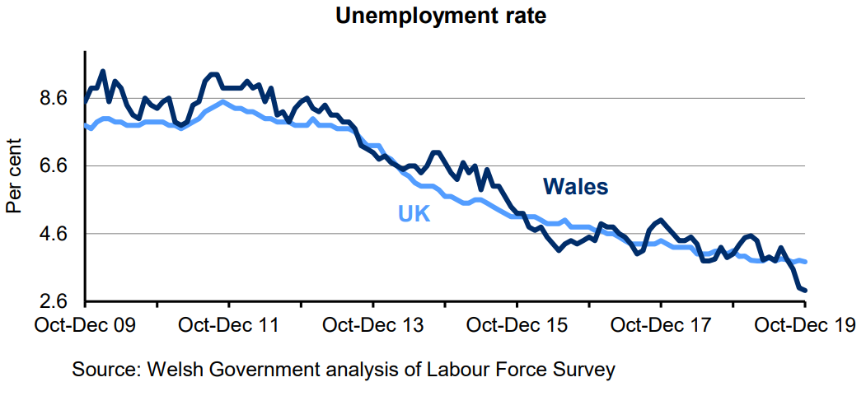
Y Farchnad lafur cyn y pandemig
Labour market prior to pandemic
Notes:
These are 2 of our headline labour market indicators that are published monthly
To give context of how the labour market was looking prior to the pandemic, charts cover year ending 2019
Generally volatility in the Welsh estimates – but generally in a relatively strong position
Lowest unemployment rate since records began and lower than the UK rate – some caution here as it can jump around but generally the unemployment rate tracks that of the UK
Employment rates generally been increasing over the longer term – peaked in the final three months of 2018 to just over 76%
Economic inactivity is the final headline indicator not included here – rate tends to jump around in Wales – longer term trend is decrease but had been increasing slightly recently. UK gradually decreasing

Slide 5
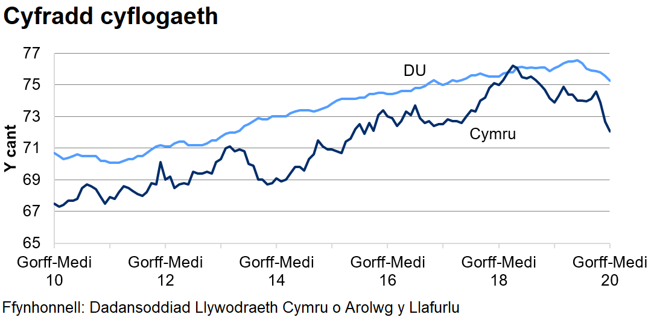
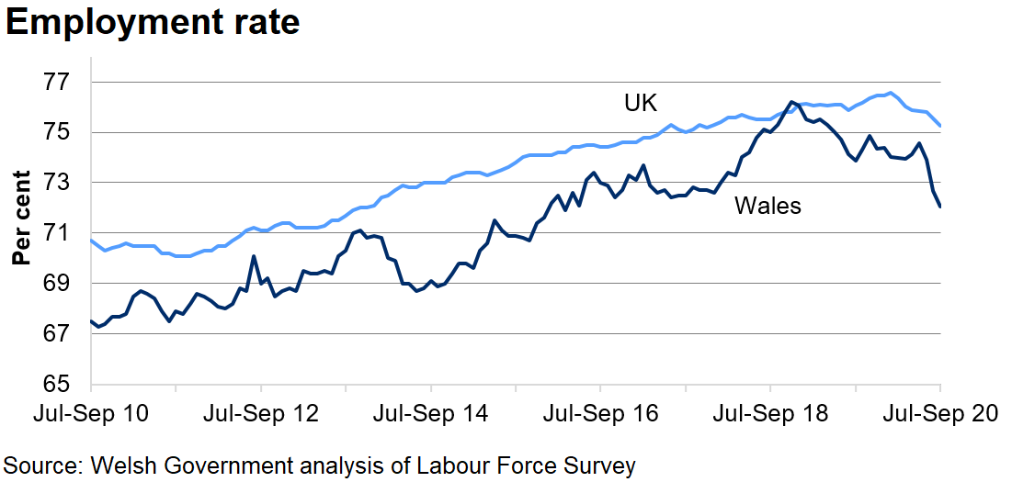
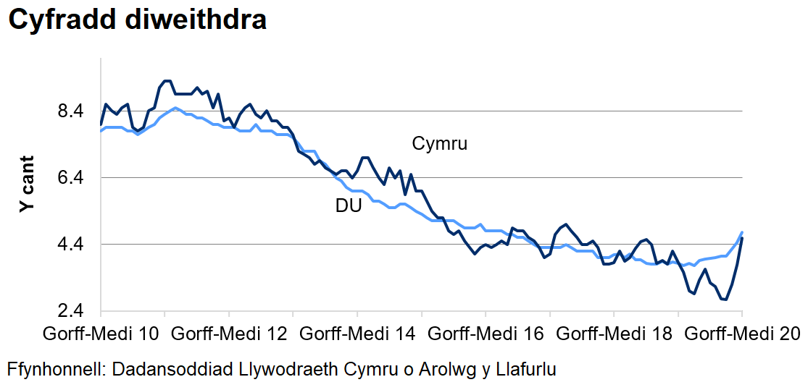
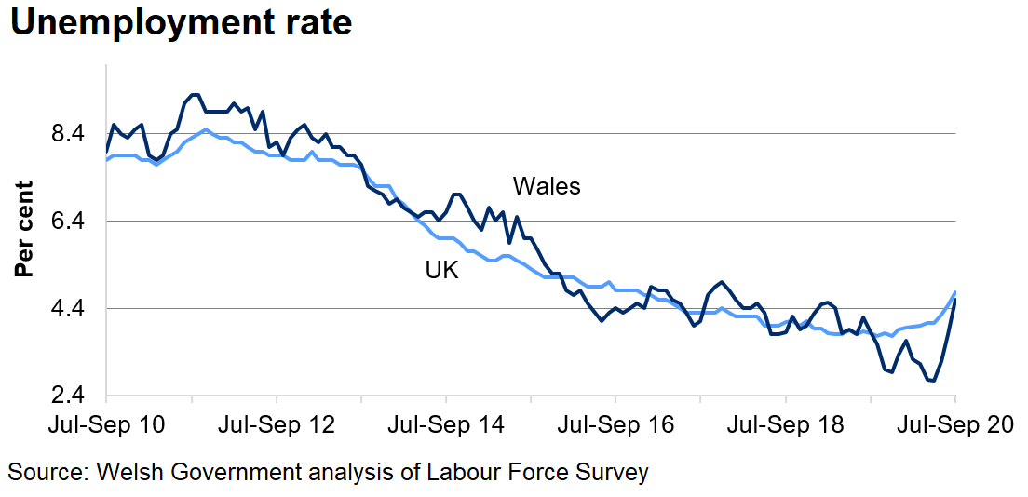
Dangosyddion diweddaraf y farchnad lafur
Latest labour market indicators
Notes:
Latest headline labour market indicators were released this week on Tuesday – usually high profile anyway, number of headlines on Tuesday
The employment rate decreased sharply in Wales (again caution over shorter term) – 2.5 pp over the quarter and 1.8 pp over the year – this was the largest quarterly decrease in Wales since the series began in 1992
And opposite with unemployment rate – increased sharply in both Wales and the UK – 1.9 pp over the quarter and 0.8pp over the year (we are talking about smaller scales here compared to employment). Again this is the largest increase in Wales in one quarter since 1992
Economic inactivity increased in Wales but not as sharply as the changes to employment and unemployment. UK economic inactivity remained broadly stable

Slide 6
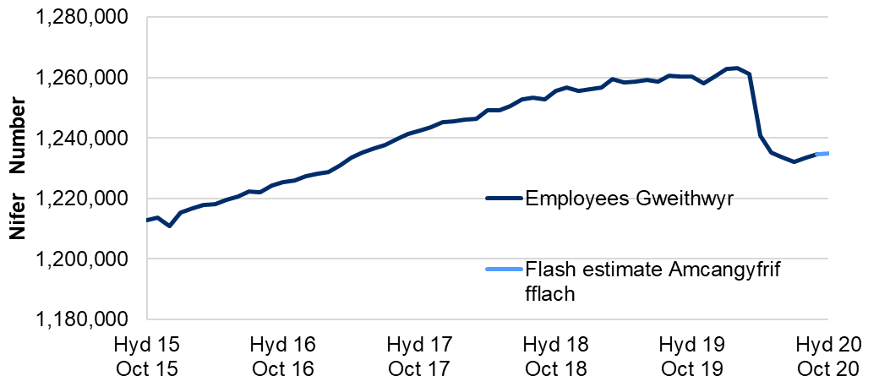
Dangosyddion eraill y farchnad lafur
Other labour market indicators
Cyflogeion cyflogedig, Cymru
Payrolled Employees, Wales
Gostyngodd gweithwyr cyflogedig i lefel isel ym mis Gorffennaf
Wedi cynyddu ychydig ers hynny, er ei fod yn parhau'n gymharol sefydlog yng Nghymru
Ledled y DU, mae'r ffigur yn parhau i ostwng
Paid employees decreased to a low in July
Increased slightly since then, although remains relatively stable in Wales
Across the UK, figure continues to fall
Notes:
Prior to the pandemic, the number of paid employees in Wales was generally increasing
• The number of paid employees decreased during the pandemic to 1.23 million in July, a decrease of 31,000 people (2.5%) compared with February 2020. However, the number of paid employees has increased slightly since August 2020, but remains well below the February figure.
• Early estimates for October 2020 indicate that the number of paid employees in Wales was 1.23 million. This was a decrease of 28,300 (2.2%) on February 2020, but a slight increase of 2,700 (0.2%) compared with the lowest point in July.

Slide 7
Dangosyddion eraill y farchnad lafur
Other labour market indicators
Cyfres cyfnewidiol – waeth pa mor fwyaf yng Nghymru ers 2009
Roedd lefel y DU yn fwy nag yn 2009
Cyfradd diswyddiadau Cymru yn debyg yn fras i'r DU
Volatile series – however largest in Wales since 2009
UK level was larger than in 2009
Redundancy rate in Wales broadly similar to UK
Notes:
Prior to the pandemic, the number of paid employees in Wales was generally increasing
• The number of paid employees decreased during the pandemic to 1.23 million in July, a decrease of 31,000 people (2.5%) compared with February 2020. However, the number of paid employees has increased slightly since August 2020, but remains well below the February figure.
• Early estimates for October 2020 indicate that the number of paid employees in Wales was 1.23 million. This was a decrease of 28,300 (2.2%) on February 2020, but a slight increase of 2,700 (0.2%) compared with the lowest point in July.

Slide 8
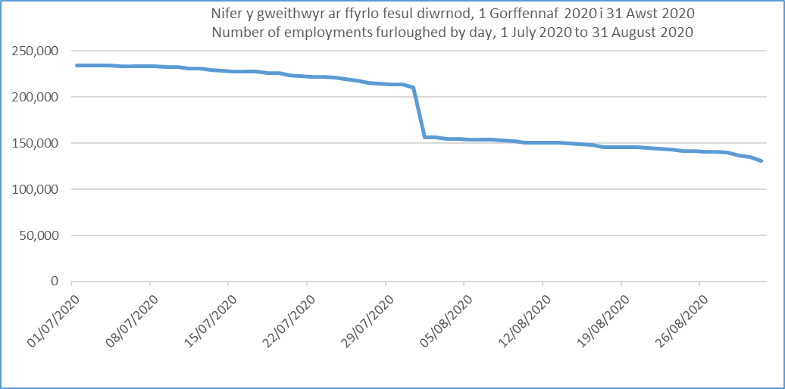
Gweithwyr ar ffyrlo
Furloughed employees
Cyfradd derbyn o 10% yng Nghymru ar 31 Awst
Yn fras yn debyg ar draws ALlau
Mwy o fenywod na dynion ar ffyrlo yng Nghymru
Mae 38% ar ffyrlo yn rhannol
90% yn parhau yn eu cyflogaeth wreiddiol
10% take up rate in Wales as at 31st August
Broadly similar across LAs
More women than men furloughed in Wales
38% are partially furloughed
90% remain in original employment
Notes:
Some time lag with these stats
As at 31st August, 130,400 employments were furloughed, 10% of all employments
More females than males were furloughed (52% female)
Take up rate broadly similar across all LAs (13% in Conwy to 8% in Neath Port Talbot). Ranges from 9% (NI) to 13% (London) across UK countries and English regions
90% of employees who left the furlough scheme between April and July remained on their original payroll

Slide 9
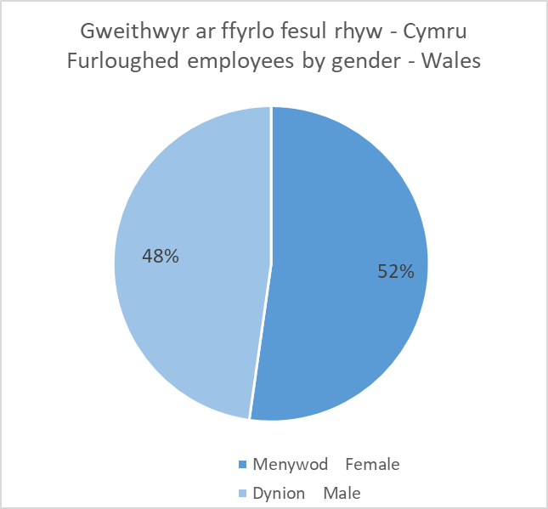
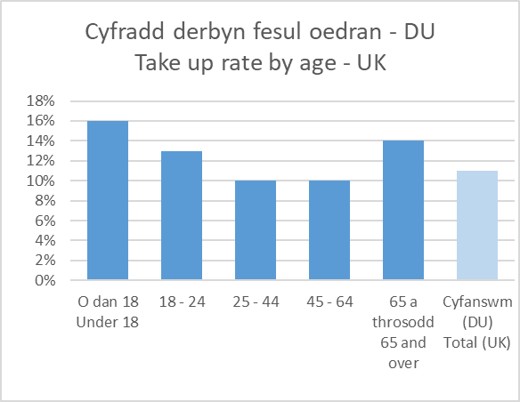
Gweithwyr ar ffyrlo parhad Furloughed employees cont.
Notes:
As at 31st August, 130,400 employments were furloughed, 10% of all employments
More females than males were furloughed (52% female)
90% of employees who left the furlough scheme between April and July remained on their original payroll
Take up rate broadly similar across all LAs (13% in Conwy to 8% in Neath Port Talbot)

Slide 10
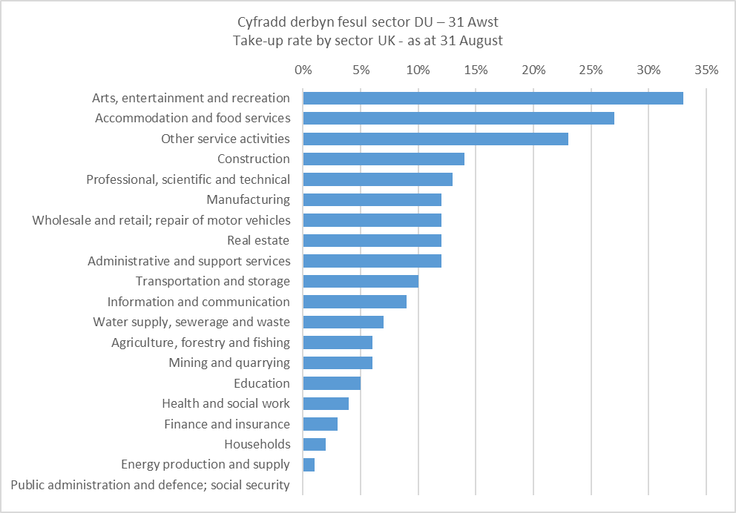
Gweithwyr ar ffyrlo fesul sector
Furloughed employees by sector
Ffynhonnell: CThEM
Source: HMRC
Notes:
As at 31st August, 130,400 employments were furloughed, 10% of all employments
More females than males were furloughed (52% female)
90% of employees who left the furlough scheme between April and July remained on their original payroll
Take up rate broadly similar across all LAs (13% in Conwy to 8% in Neath Port Talbot)

Slide 11
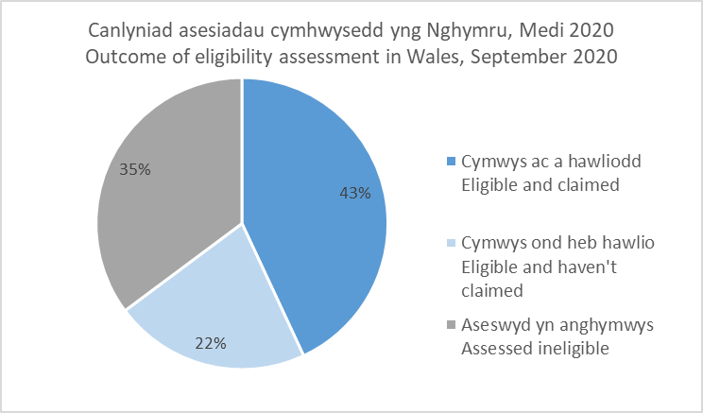
Cynllun Cymorth incwm hunangyflogaeth
Self-employment income support scheme
Hyd ddiwedd Medi, 93,000 o geisiadau llwyddiannus ar gyfer yr ail SEISS
Caeodd y SEISS cyntaf ar 13 Gorffennaf – dros 110,000 o hawliadau (78% o'r rhai cymwys)
Hawliadau wedi’u dominyddu gan y sector adeiladu
Amrywiadau fesul ALl
Amrywiad bychan yng ngwerth cyfartalog hawliadau
Up to end of September, 93,000 successful claims for the second SEISS
First SEISS closed on 13th July – over 110,000 claims (78% of those eligible)
Claims dominated by construction sector
Variation by LA
Little variation in average value of claims
Notes:
Add text here – also more likely to be male
Remind of eligibility rules
Construction dominateos

Slide 12
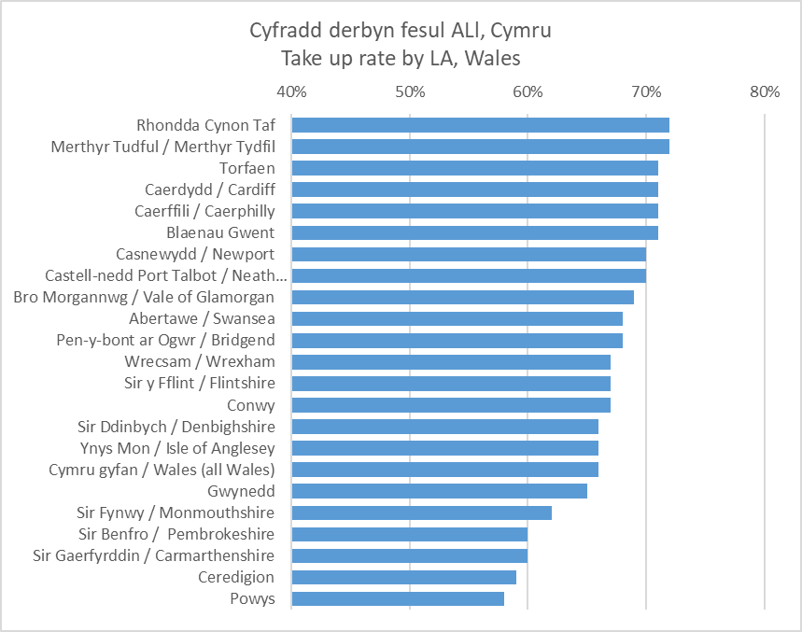
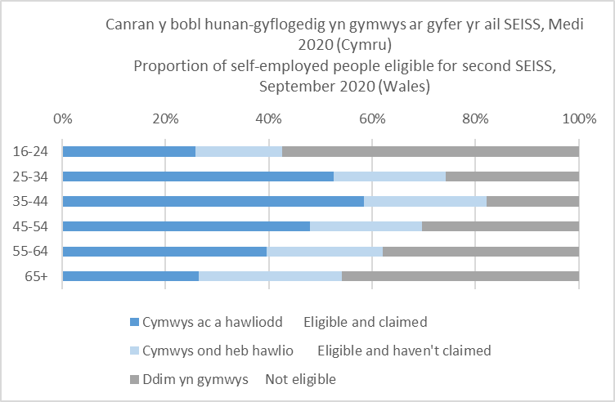
Cynllun Cymorth incwm hunangyflogaeth
Self-employment income support scheme
Notes:
As at 31st August, 130,400 employments were furloughed, 10% of all employments
More females than males were furloughed (52% female)
90% of employees who left the furlough scheme between April and July remained on their original payroll
Take up rate broadly similar across all LAs (13% in Conwy to 8% in Neath Port Talbot)

Slide 13
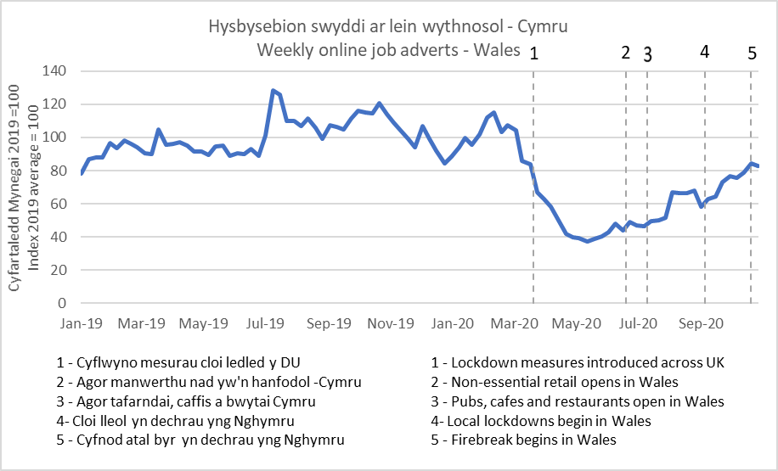
Swyddi Gwag Job Vacancies
Mae nifer y swyddi gwag ar-lein wedi adfer rhywfaint yng Nghymru
Amrywiadau mewn adferiad a dirywiad cychwynnol fesul diwydiant
Mae adferiad arlwyo a lletygarwch wedi arafu
Diwydiannau eraill welodd llai o effaith - gofal iechyd a gofal cymdeithasol
The number of online vacancies have recovered somewhat in Wales
Variation in recovery and initial decline by industry
Catering and hospitality recovery has stalled
Other industries less impacted are healthcare and social care
Notes:
Generally some volatility
Fell quite sharply at the beginning of the lockdown
The scale of the fall was consistent with that across the UK

Slide 14
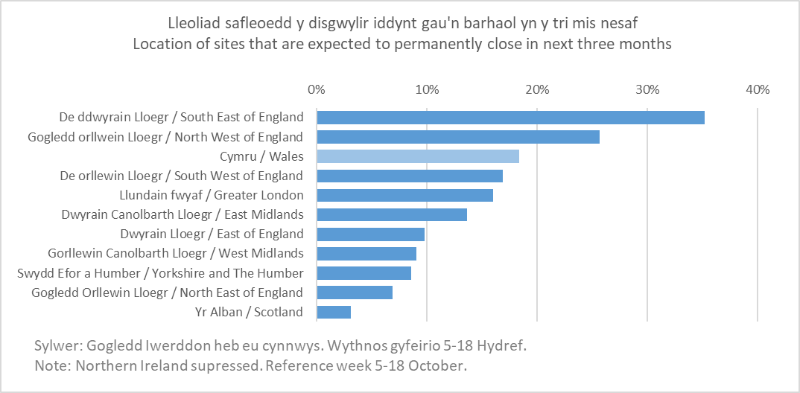
Business Impact of Coronavirus Survey (BICS)
Tua 2% o fusnesau a sefleoedd wedi rhewi neu wedi rhoi'r gorau i fasnachu yng Nghymru (trydydd uchaf)
Ledled y DU, busnesau'n disgwyl diswyddo 9% o'u gweithlu yn ystod y tri mis nesaf
Mae gan Gymru un o'r cyfraddau uchaf o fusnesau sy'n ychwanegu at gyflogau ffyrlo
Mae 22% o fusnesau'n bwriadu cynyddu gweithio yn y cartref yn barhaol
Around 2% of businesses had sites paused or ceased trading in Wales (third highest)
Across the UK, businesses expect to make 9% of their workforce redundant in the next three months
Wales has one of the highest proportion of businesses topping up furlough pay
22% of businesses intend to permanently increase homeworking
Notes:
Summary about BICS, what it covers, what is available, how frequently etc
London had almost 4%, North West 2%
42% of business topping up furlough pay in Wales, topped only by London (45%) Norther Ireland lowest at 35%

Slide 15
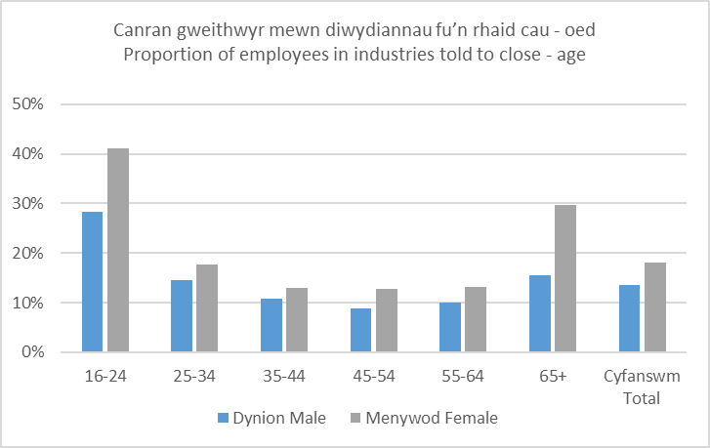
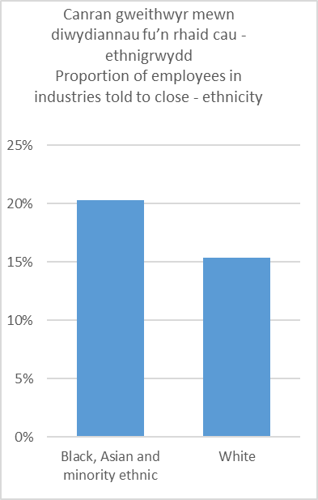
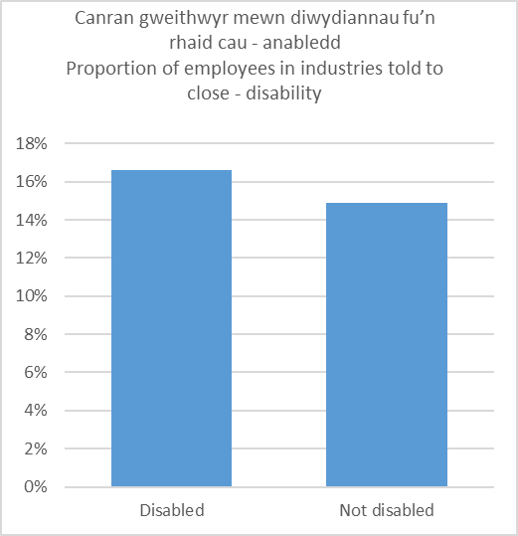
Characteristic analysis
Notes:
Generally some volatility
Fell quite sharply at the beginning of the lockdown
The scale of the fall was consistent with that across the UK

Slide 16
Casgliadau Conclusions
Covid-19 having a significant impact on labour market:
  Headline labour market indicators show decreasing employment and increasing unemployment.
  Redundancies data considerably higher than recent years.
Nature of employment in the sectors that have been impacted the most by the COVID-19 pandemic means that effects will tend to worsen inequalities.
Continue to analyse labour market data as pandemic continues.
Notes:
Covid-19 having a significant impact on labour market, with data sources now showing scale of impact
Latest headline labour market indicators show decreasing employment and increasing unemployment – with considerable quarterly changes.
July to September 2020 saw the largest number of redundancies in Wales since mid-2009, with numbers significantly higher than in recent years
The nature of employment in the sectors that have been impacted the most by the COVID-19 pandemic (eg young, disabled) means that effects will tend to worsen inequalities.
While the data sources currently available give us an indication of how many people are being affected, as time goes on and more data is available to us, we will also have a clearer picture of who has been. We will continue to analyse the labour market data as the pandemic continues to progress.

Slide 17
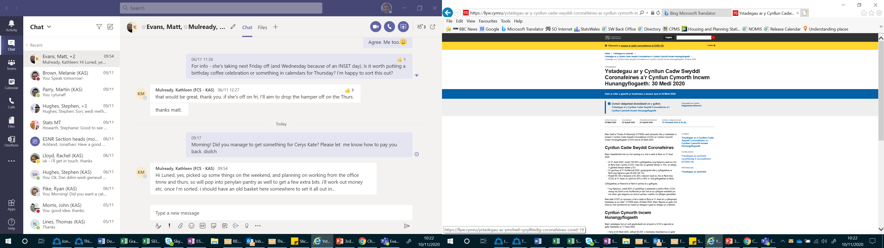
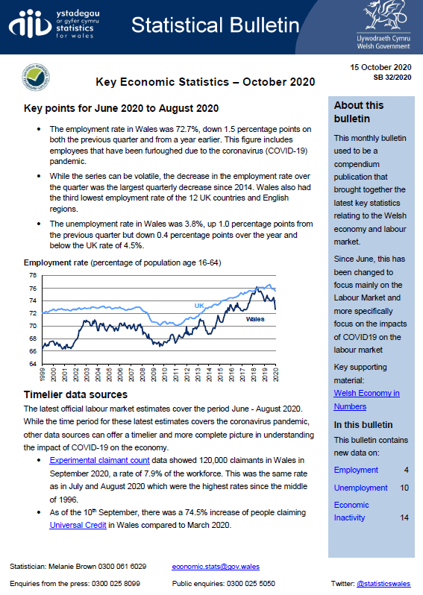
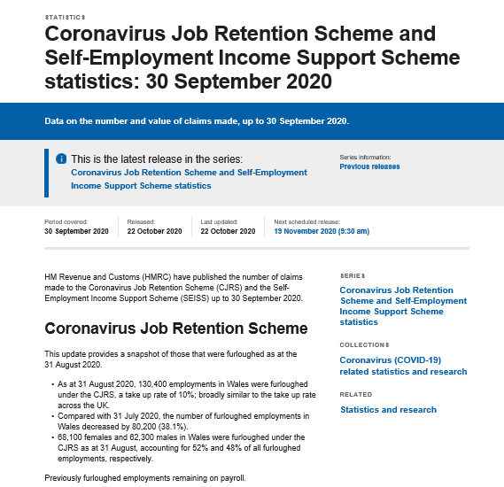
Notes:
Data sources talked about today are a mixture of long-standing statistical surveys, management/administrative information and new surveys/data sets. These are all published by other organisations such as ONS, HMRC and ?? And the underlying data is generally available on their website.
Most of the labour market statistics talked about today are summarised in our Key Economic Statistics monthly bulletin which is available on our website - latest publication was this morning.
We also publish regular statistical headlines on the Coronavirus job retention scheme and the self-employment support scheme, and information on the number of apprentices furloughed.

Slide 18
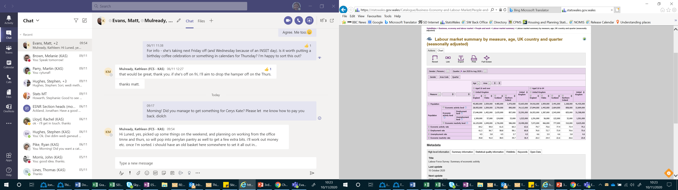
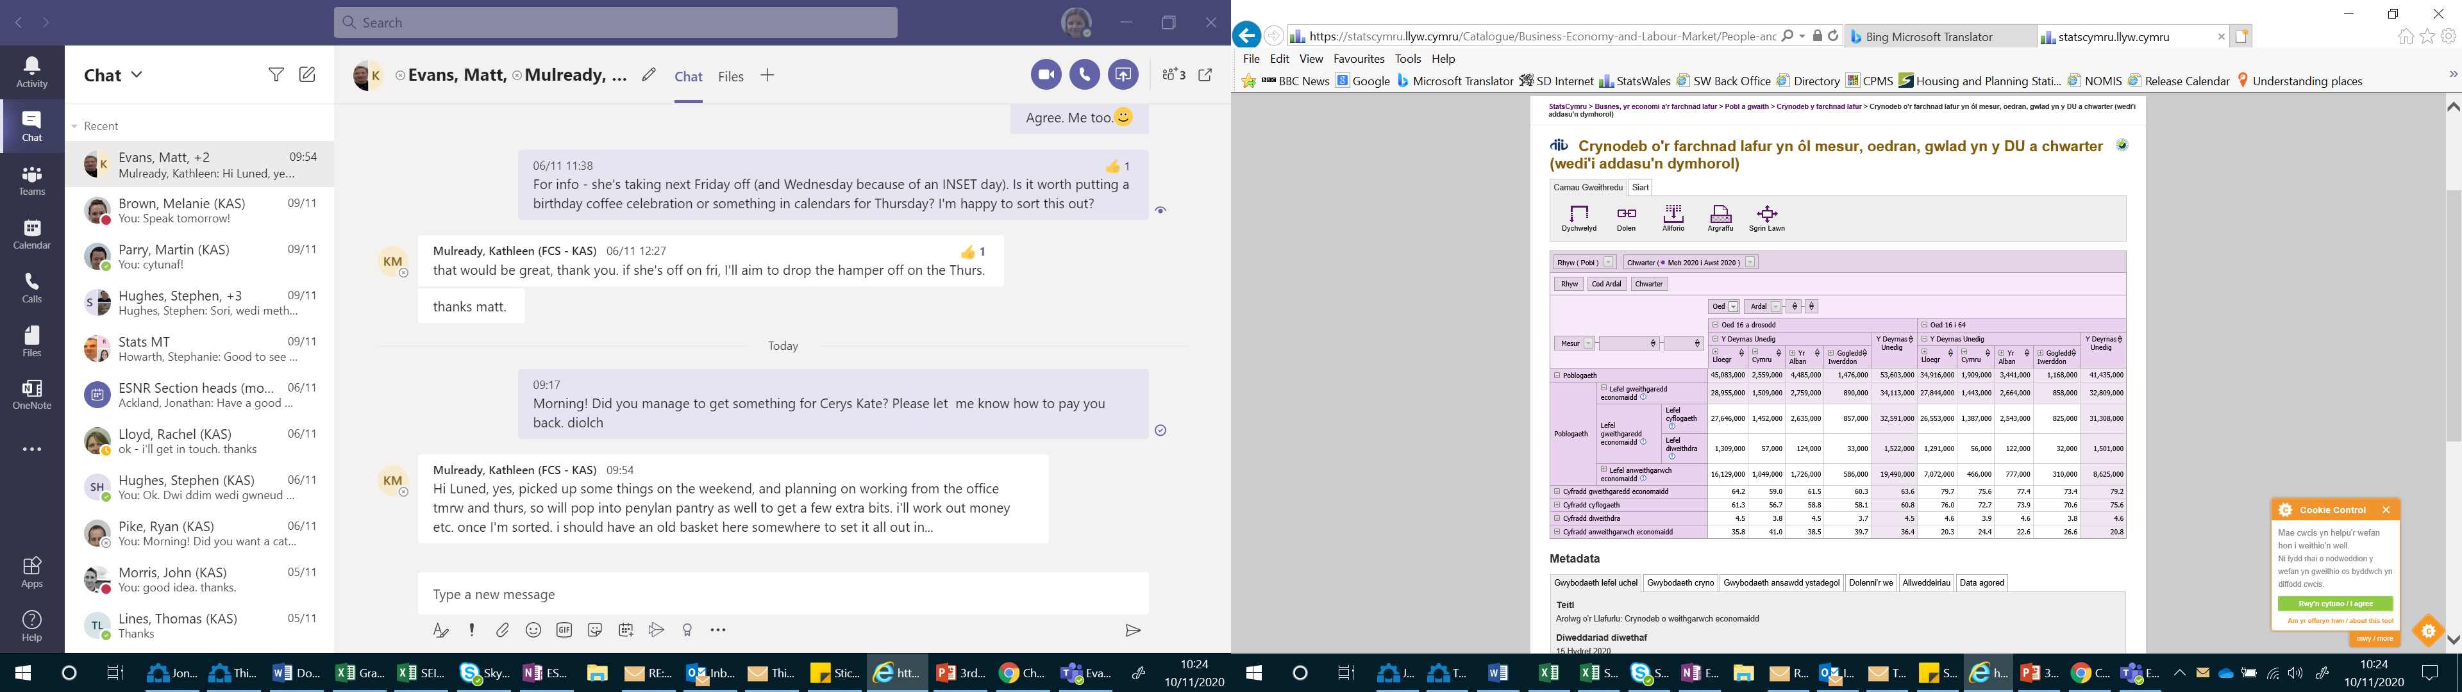
www.statswales.gov.wales
www.statscymru@llyw.cymru
Notes:
Data also published on our statswales website – key labour market headline indicators.
Other statistics relating to the wider economy are also available eg GDP, Short Term Output Indicators and a number of Business Surveys – again many summarised via statistical headlines and StatsWales datasets.
As well as information available on our website and other government websites, aware that there are other organisations publishing their own analysis and dashboards – for example aware that the Learning and Work Institute have published regular briefings on the labour market figures, and Data Cymru have published a dashboard of some of the key economic data.

Slide 19
Gwybodaeth bellach
Further Information
www.ons.gov.uk
https://llyw.cymru/ystadegau-ac-ymchwil
https://gov.wales/statistics-and-research
Ystadegau.economi@llyw.cymru
Economic.stats@gov.wales
Notes:
- We are currently facing considerable resource challenges – Mel’s team are very busy producing briefings and updates on the latest available data as well as responding to a considerable number of ad-hoc Covid requests and inputting to discussions about restrictions in Wales.
But, we would welcome feedback on our outputs – whether that be feedback on how you’ve used our publications, or how they could be improved (can’t promise to respond immediately, but always happy to listen).
Diolch yn fawr.

