Slide 1
Prosperous Valleys, resilient communities
Victoria Winckler & Helen Cunningham
16th October
@BevanFoundation
@vwinckler @cunninghamhel

Slide 2
What we do
We are Wales’ most influential think-tank. We aim to end poverty and inequality by working with people to find effective solutions and by inspiring action.
Gain insights
Develop solutions
Create change

Slide 3
Key elements for the valleys’ future
Long term plan – 10 years plus
Ambitious
Deliverable
Build on assets
Recognise complexity
Focused on building the economy and creating jobs
Root causes

Slide 4
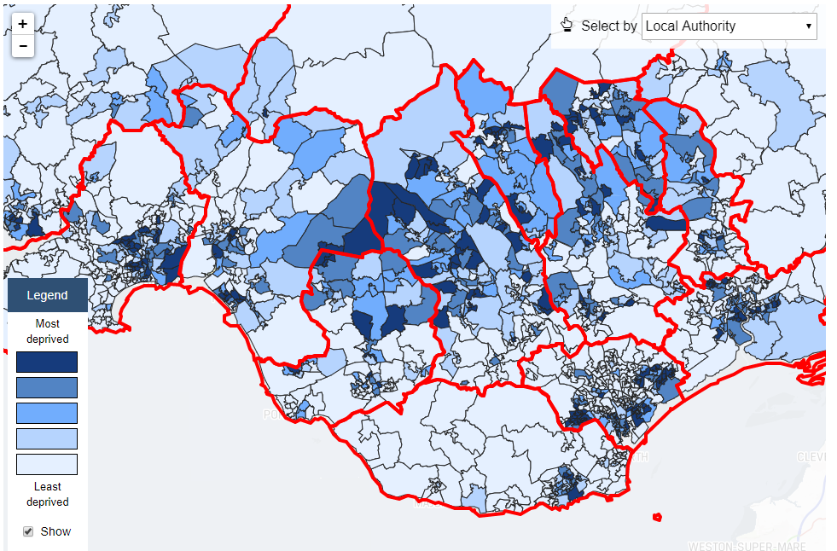
Deprivation – but not everywhere
WIMD 2014 shows:
  Strong concentration of deprivation in upper valleys
  Some LSOAs in least deprived fifth
Source: Stats Wales

Slide 5
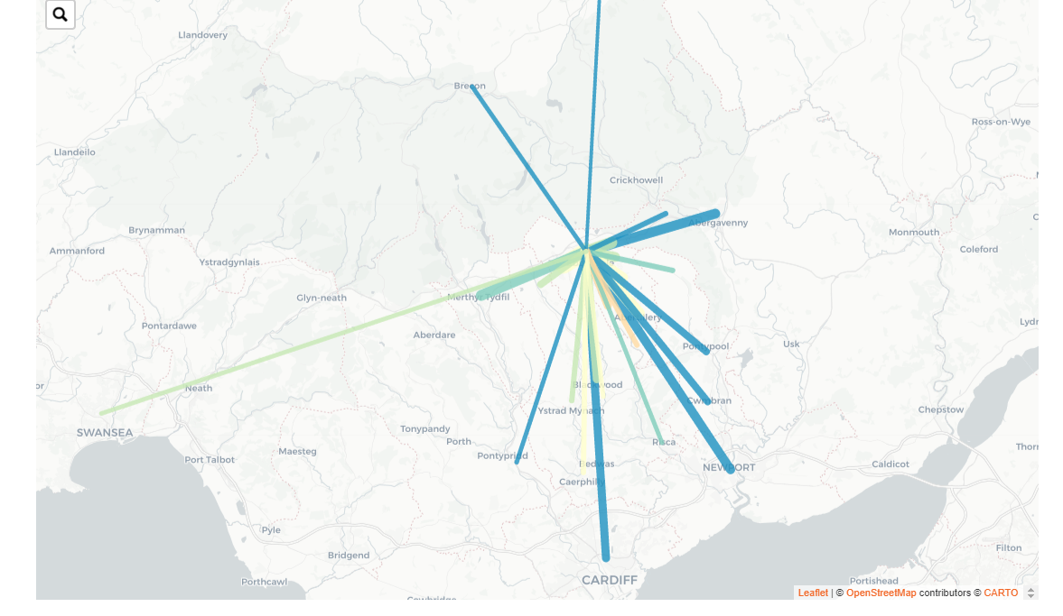
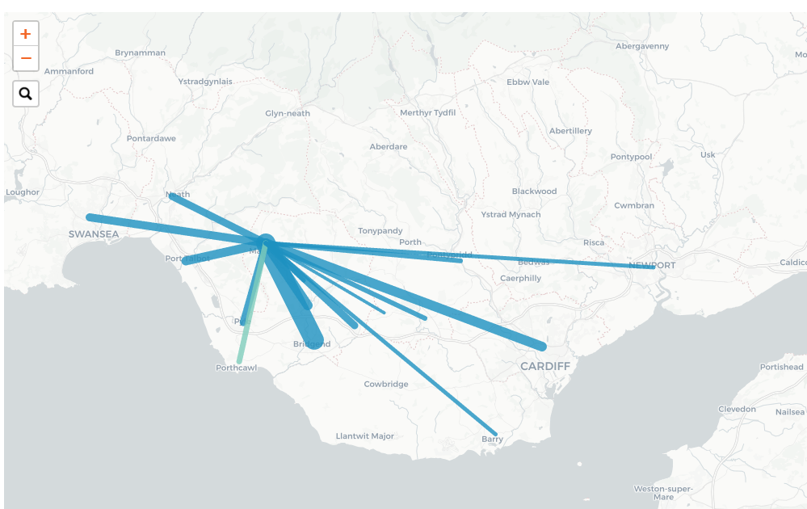
Complex travel to work patterns
Not all commuting is north – south to cities
Importance of cross-valley
Ebbw Vale
Maesteg
Source: Understanding Welsh Places

Slide 6
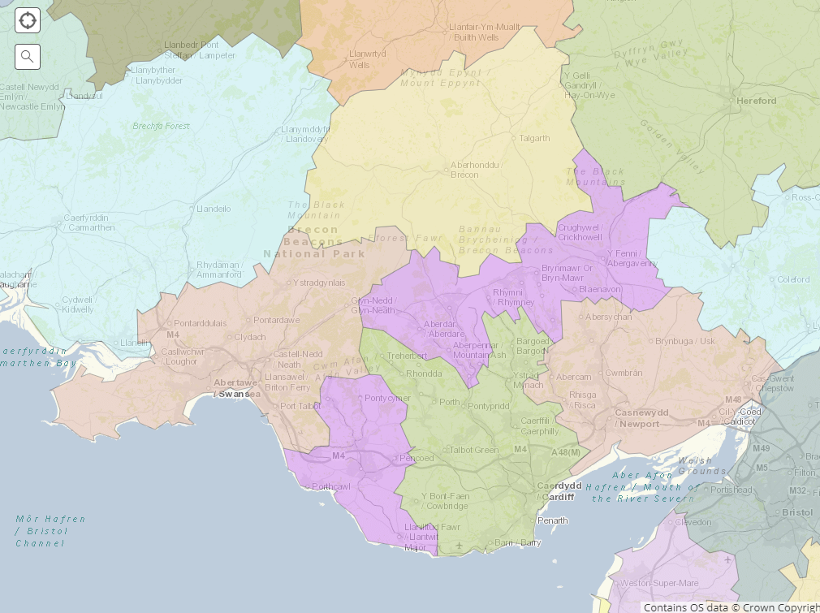
Heads of the valleys as a sub-region
Merthyr TTWA
Large footprint:
  Across local authorities
  Into mid Wales
100,000 jobs
10% of Wales’ manufacturing jobs
Source: Office of National Statistics

Slide 7
1. Action to build the whole economy
Action for manufacturing
  Large presence
  High productivity
  Good terms & conditions
  Skills
  Jobs here now – not in the future
  Yet leaking away
Meet challenges in the foundational economy:
  Terms & conditions of jobs
  Some sectors in decline
  Sustainability in low income areas

Slide 8
2. Develop anchor towns
Vital counter for cities’ pull
Key ingredients
Build on ‘strategic hubs’
Sizeable population
Strong local transport network
Anchor institutions
Growth potential
Develop access:
  local public, private and green transport
Improve town centres
Core public services
Diverse consumer services
Develop business services

Slide 9
3. Make the most of assets
People
Infrastructure
Social fabric, prevention, skills
Capacity
Business support and development
Devolution of power and control to communities
Assets V liabilities
Natural resources
  Valleys Regional Park, Project Skyline
Sustainability
Economic contribution, social value
Making assets more productive

Slide 10
4. Maximise A465 & metro …
A465
Metro
£1,000 million+ on A465
Offers:
  Connectivity for businesses & alternative to M4
  Connectivity for people across valleys
  Strategic interchanges
  Strong new identity
£700 million+ on Metro
Offers:
  Two-way connectivity
    a Cardiff dispersal policy?
  Connectivity across valleys as well as north - south
  New housing development

Slide 11
… for example
Improve business links to A465
  Direct access for industrial estates
  Better town centre access
  Services e.g. petrol, cafes, toilets, picnic sites
Demonstrate Welsh Government commitment :
  Relocate NDPB offices
  Relocate / new cultural offer – Tate Merthyr? Opera Ebbw Vale? Choral Crynant?
Better public transport along A465
  E.g. bus Merthyr - Swansea

Slide 12
Action now for the future
Brexit
Climate change
Automation and skills needs
Demographic change
Inequality

Slide 13
Thank you
https://www.bevanfoundation.org/
With thanks to our partners Cynon Taf Housing Association, Hafod, Merthyr Tydfil County Borough Council, Merthyr Valleys Homes, Neath Port Talbot Council, Rhondda Cynon Taf County Borough Council, Tai Calon, United Welsh and Unltd

