Slide 1




Understanding Welsh Places

Slide 2

Background to the Project
Research by Carnegie UK Trust identifies a policy and advocacy gap when it comes to towns
Also a shortage of robust data on towns and smaller communities
Understanding Scottish Places well received
Carnegie published recommendations relating to Welsh towns
UWP funded by Carnegie and Welsh Government

Slide 3
Aims and Objectives
Be the first point of call for statistical information about towns and communities in Wales
Support people to use the data presented to identify opportunities in their areas
Inspire communities, place makers and policy makers to make positive changes in the places where they live and work

Slide 4
How is UWP different?
Data at a town/ community level
Accessible user interface
Extra levels of analysis (for places with 2,000+ residents)
Encourage comparisons and conversations between places
Narrative descriptions
Communities can share their plans and research

Slide 5
Data and maps: UWP 1
Population (including age distribution and ethnic groups)
Welsh language and national identity
Employment and education
Social conditions
Services: numbers of shops, schools, GPs, dentists, charities
Air quality and active travel
Common commuter journeys between places in Wales
Rural indicators

Slide 6
Data and maps: Version 2
Access to green space and blue space
Cultural assets and participation
Tourism
Internal migration
Mobile and superfast broadband coverage
Wish list
Co-ops and social enterprises
Sports and leisure
Childcare
Democratic engagement

Slide 7
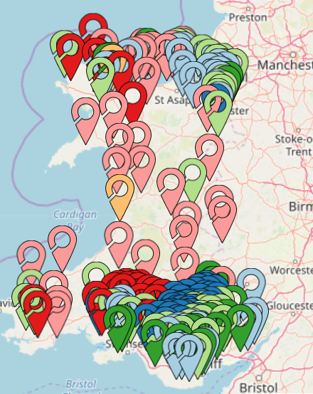
Additional analysis
Classification of place
Similar places over 2000+ people clustered and mapped
Clustering based on demographic and socio-economic characteristics
7 categories of places
Classification descriptions for places in each category
Can be used as a tool to compare similar places
Unexpected synergies

Slide 8
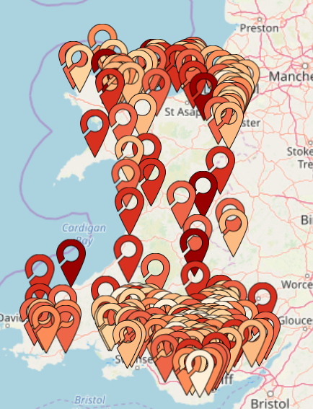
Additional analysis
Inter-relationship assessment
How much does your place rely on other places for public, commercial and social assets?
How much do other places rely on your place for these assets?
Does this make your place independent, dependent or inter-dependent?
Can be used as a tool to compare places

Slide 9
Indicators used to create inter-relationship score
    Number of registered charities
    Number of GPs and Dentists
    Number of hospitals
    Number of children in primary schools
    Number of children in secondary schools
    Number of jobs
    Diversity of jobs
    Public sector jobs
    Number of shops
    Diversity of retail offer
    Distance travelled to work

Slide 10
Places classified into seven types
based on score
Independent places have a high number of assets in relation to their population; a strong diversity of jobs; and residents travel shorter distances to travel to work.
Independent to Interdependent places.
Interdependent to Independent places
Interdependent places have a medium number of assets in relation to their population; average diversity of jobs; and residents travel a mix of short and long distances to travel to work.
Interdependent to Dependent places
Dependent to Interdependent places
Dependent places have a low number of assets in relation to their population; a reliance on one sector for jobs; and residents travel longer distances to work.

Slide 11
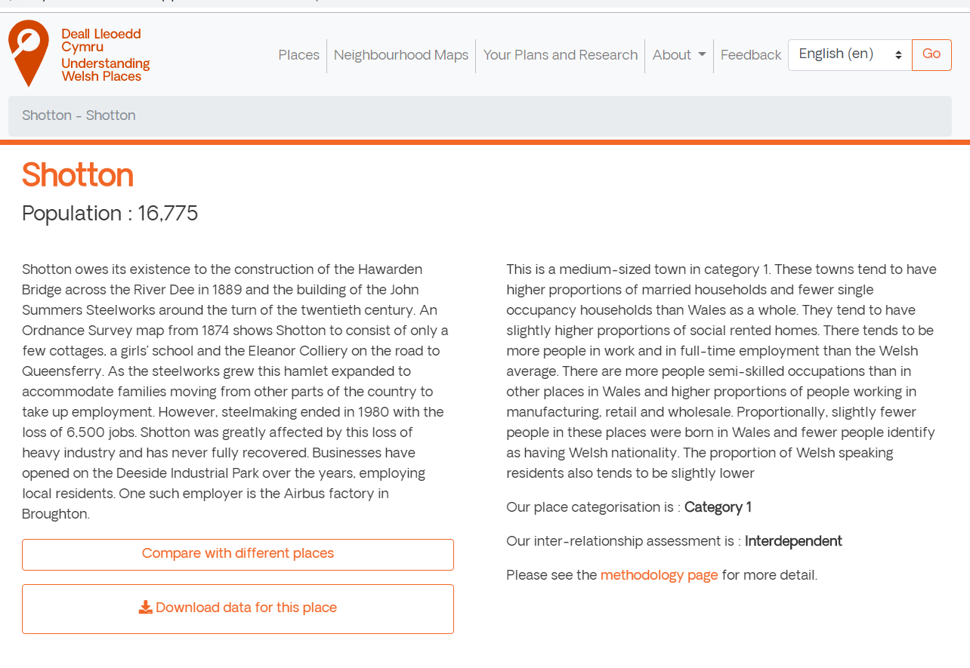
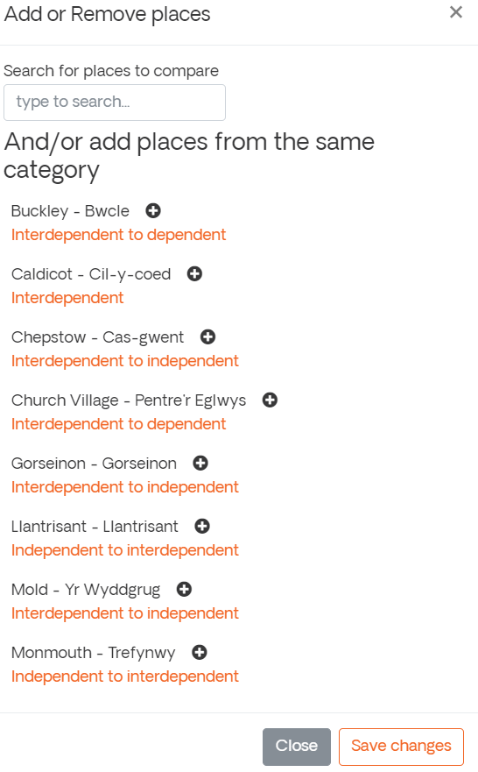
Compare places by Category and Inter-relationship type

Slide 12
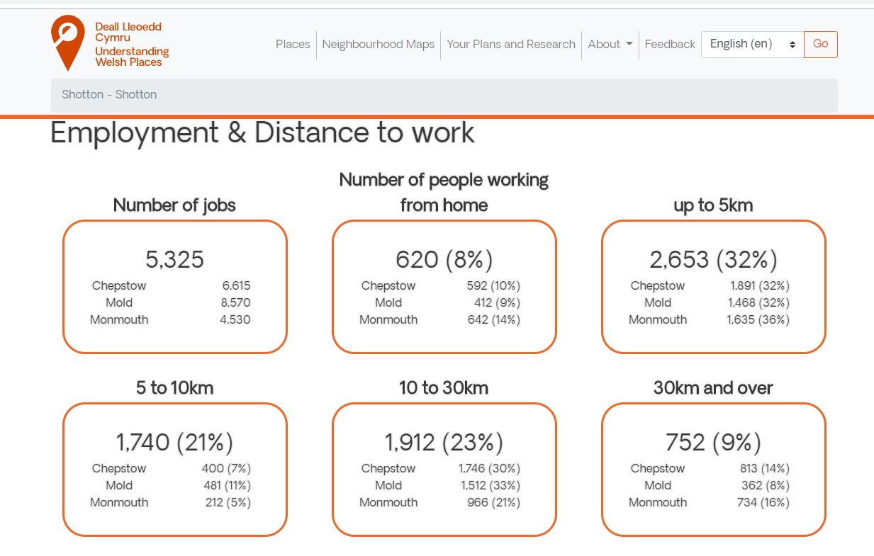
Compare places

Slide 13
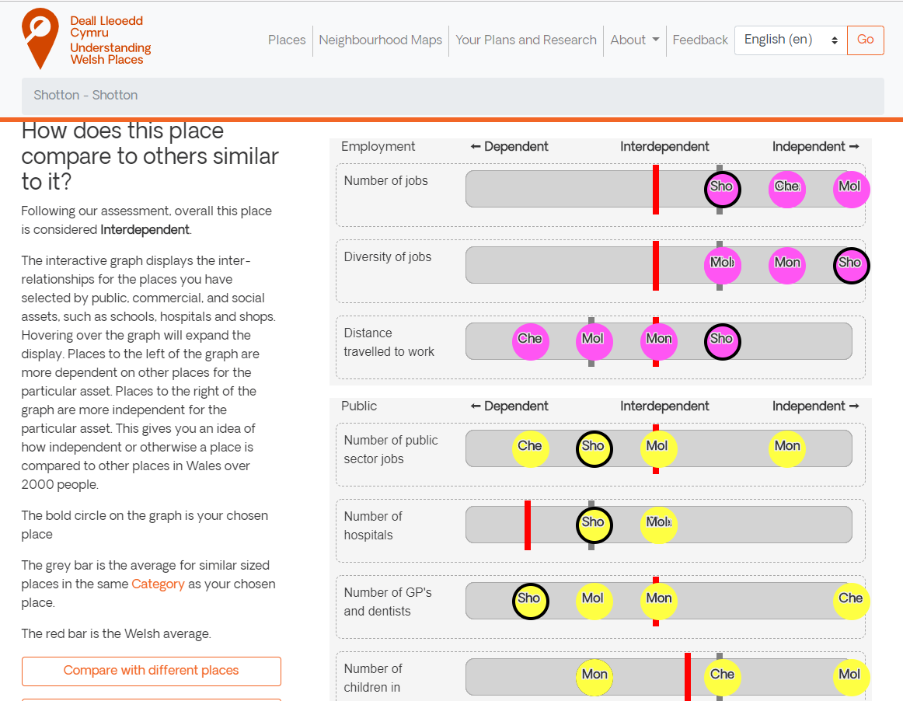

Slide 14
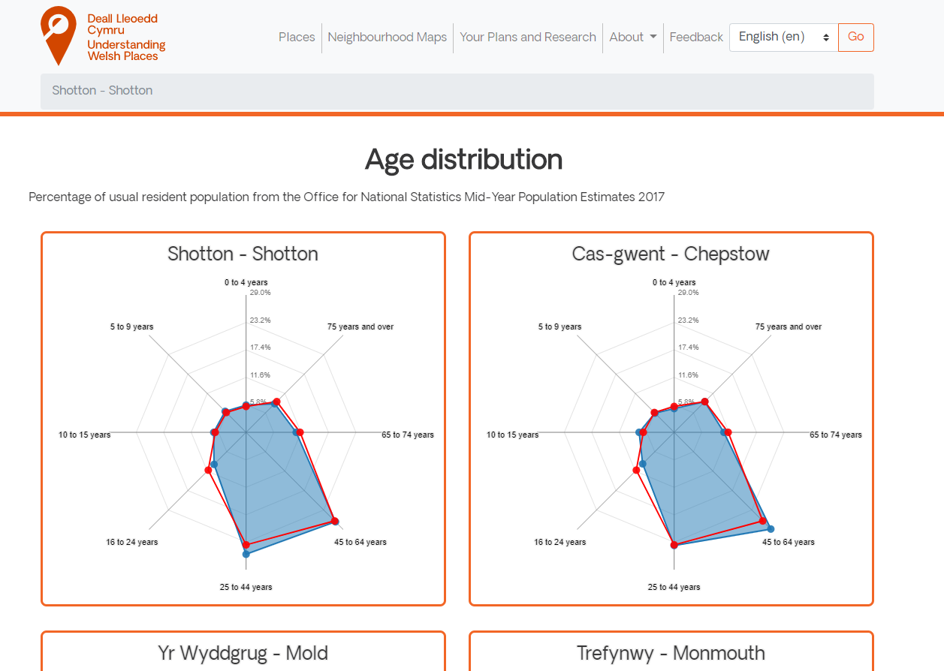

Slide 15
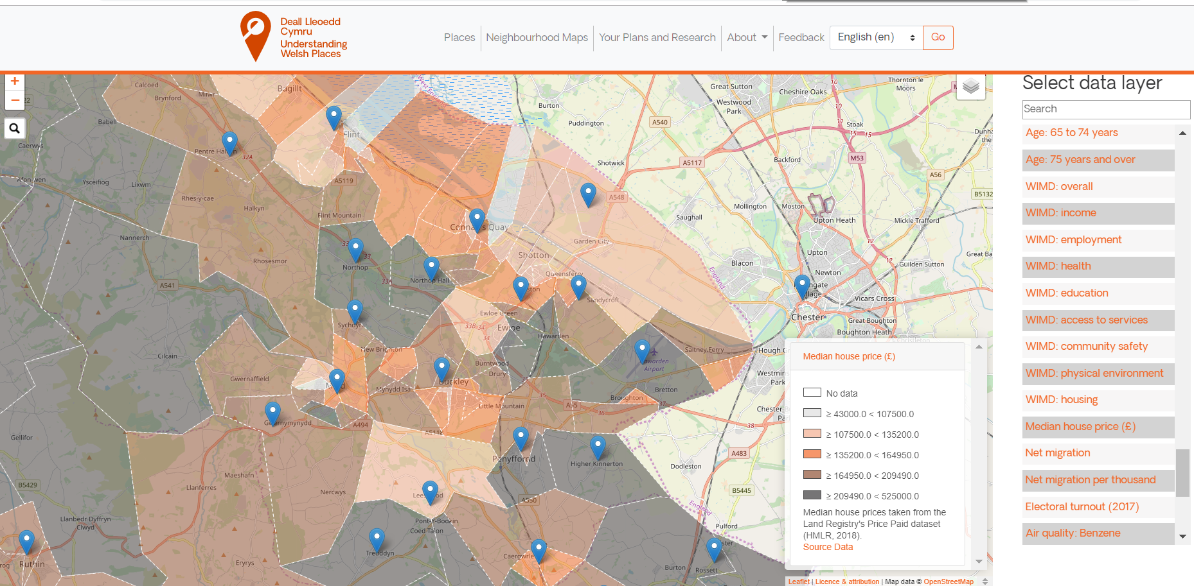
Additional Analysis
Mapping Neighbourhood Data

Slide 16
elinor.shepley@iwa.org.uk / 029 2048 4387
www.understandingwelshplaces.wales
www.deall lleoeddcymru.cymru

